Slide 1

50.039 Theory and Practice of Deep Learning W1-S1 Introduction and Machine Learning Reminders
Matthieu De Mari

Slide 2

A quick word about instructors
Matthieu (Matt) De Mari
Lecturer at SUTD (Python, Deep Learning, AI, and more)
Information Systems Technology and Design (ISTD) pillar/faculty
PhD from CentraleSupelec (France)
Email: matthieu_demari@sutd.edu.sg
Office @ SUTD: 2.401.07

Slide 3
Objectives of 50.039 DL
Introduce the technical aspects related to the implementation of Deep Neural Networks from scratch.
Teach the students about the most popular framework for implementing Deep Neural Networks (as of Jan 2023): PyTorch.
Discuss the mathematical foundations and intuitions behind the Deep Learning framework, layers and some techniques.
Give the students a global overview of the advanced techniques related to Deep Learning and Deep Neural Networks.
Describe examples of practical applications of Deep Learning, showing how some key AIs were implemented using Deep Learning.

Slide 4
Objectives of 50.039 DL
Eventually, assemble all concepts and tricks of the trade discussed in this course to produce big architecture models that are close to the current state-of-the-art ones (e.g. ChatGPT, Dall-E, etc.).
Discuss ethical aspects related to some of the concepts discussed.
Give students an understanding of the current state of research in the Deep Learning community, and more specifically pointers as to where the most up-to-date information can be found.
This includes tracking big names in the field, identifying key scientific papers that have changed the field, but also newsletters, websites or magazines that disclose information in layman terms.

Slide 5
Skills needed for this course
Must-have CS: Python, Numpy, Matplotlib.
Must-have Math: Linear Algebra, multiple variables calculus, derivatives, optimization probability and statistics.
Good-to-have CS: Machine Learning, Data Processing, Scipy, Sklearn.
Good-to-have Math: Graph Theory, Game theory.
Need to revise? Time to check your 10.014 CTD, 10.013 M&A, 10.018 MS&S, 10.022 MU, 10.020 DDW, and 50.007 ML!

Slide 6
The way I teach things
An expert is not someone who
Undertook a 6h-long online course,
Implements Neural Networks using basic layers (Linear, Conv, and that is it),
Using a random framework he does not understand (or autoML!),
and is happy to get an 80% accuracy on a simple dataset like MNIST.
An expert is someone who
Understands how Neural Network operate and the mathematical intuition behind typical (advanced) operations,
Understands how the frameworks have been built and what they do behind the scene.
Someone who knows how to stay up to date when it comes to AI.

Slide 7
The way I teach things
One topic per week (or so) and hopefully, we will cover all the important concepts and important directions of DL these days.
Lectures slides uploaded the day before, and supporting notebooks.
Mathematical aspects discussed in class (behind the scene of Neural Networks/Deep Learning).
Made a choice: providing lots of code to demonstrate concepts, but need you to play with them autonomously to explore concepts!
Extra reading, for curiosity (supporting papers, articles, etc.) and suggestions of pointers to follow to stay up to date.
Suggestions for continuing your learning, after this course.

Slide 8
Syllabus
Week 1: Introduction to course, some ML jargon reminders, linear and polynomial regression, generalization, ridge regression and regularization, overfitting/underfitting, logistic regression, neurons objects and how they relate to biology, our first shallow neural network, gradient descent reminders, training and testing procedure.
Week 2: Introduction to PyTorch framework, tensors and dataloaders, implementing a shallow neural network in PyTorch, backpropagation in PyTorch with AutoGrad, advanced optimizers, multi-label classification with shallow neural networks, moving from shallow to deep neural networks.

Slide 9
Syllabus
Week 3: Guided project and good practices for Deep Learning projects (train/test/dev, bias/variance, advanced regularization, dropout, normalizing inputs/outputs/layers, trainer functions, savers/loader functions for reproducibility and transfer learning).
Week 4: The image data type, image processing techniques and typical computer vision operations, the convolution operation and layers, Convolutional Neural Networks, advanced CNNs and SotA. Preparing transition to the 50.035 Computer Vision course.

Slide 10
Syllabus
Week 5: Sequential data (times series, text, etc.), vanilla Recurrent Neural Networks, Gated Recurrent Units, Long-Short Term Memory cells, advanced RNN networks, mixing models for advanced architectures and project announcement.
Week 6: Adversarial machine learning, attacking a Neural Network with basic gradient-based attacks, fundamental limits of Neural Networks, defense mechanisms and state-of-the-art of some advanced attacks techniques. MidTerm exam (based on W1-5).

Slide 11
Syllabus
Week 8: The embedding problem, more advanced concepts on RNNs, introduction to Natural Language Processing (NLP) and Word Embeddings for NLP, brief state-of-the-art on NLP, attention and transformers architectures. Preparing transition to the 50.040 Natural Language Processing course.
Week 9: Quick introduction to Graph Theory and typical graph datasets and problems, basics of Graph Convolutional Networks, brief state-of-the-art of advanced Graph Convolutional Networks.

Slide 12
Syllabus
Week 10: Generative Models, Autoencoders and Variational Autoencoders, Generative Adversarial Networks (GANs), Advanced concepts on Generative Adversarial Networks, Practice on GANs.
Week 11: Brief introduction to reinforcement learning, and state-action-rewards systems, multi-armed bandit problem and the exploration/exploitation trade-off, Q-learning and Deep Q-Learning. Brief state-of-the-art discussion about further works in Reinforcement Learning.

Slide 13
Syllabus
Week 12: Explainability/Interpretability and open questions in research about Neural Networks. Deep belief models and diffusion models. What will be the next revolution in AI? (a word on ChatGPT, Dall-E, etc.). Closing and future directions for studying Deep Learning.
Week 13: Recap. Project presentations and guest conferences (TBA).
Week 14: Final exam (probably W1-13).

Slide 14
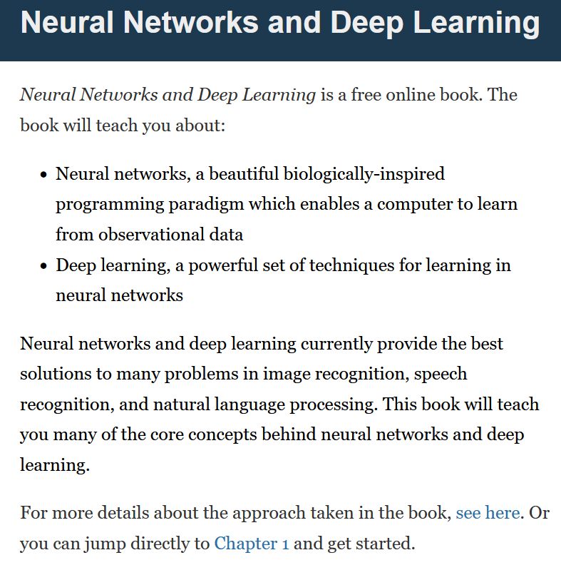
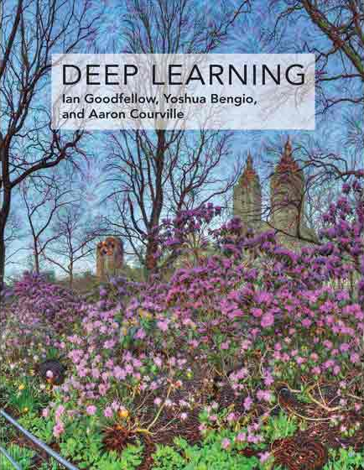

Supporting Textbooks
Supporting textbooks, for your curiosity (not needed to understand this course).
Michael A. Nielsen, “Neural networks and deep learning”, 2015. (http://neuralnetworksanddeeplearning.com/)
Ian Goodfellow, Yoshua Bengio and Aaron Courville, “Deep learning”, 2016. (https://www.deeplearningbook.org/)
Stevens et al., “Deep Learning with PyTorch”, 2020. (https://www.manning.com/books/deep-learning-with-pytorch)

Slide 15
Evaluation and grading
Homeworks (24%): Given on Weeks 2, 5, 8, 10. Usually come in the form of a Jupyter Notebook, containing explanations, code snippets and questions. Submissions on eDimension, two weeks later or so, as a small PDF report containing code, figures and answers to questions. When time allows, debrief of homeworks in class.
MidTerm Exam (20%): Given on Week 6, March 1st 2023. Theoretical, paper exam, notions of Week 1-5 to be tested. More details about venue and exam details to be announced closer to the exam date.

Slide 16
Evaluation and grading
Final Exam (20%): Given on Week 14, April 26th 2023. Theoretical, paper exam, notions of Week 1-13 to be tested. More details about venue and exam details to be announced.
Project (29%): Groups of 2-3 students. Submission for project (code, report, presentation) expected on Week 13. Problem statement to be freely decided by students, as long as it matches a list of given requirements. We will have a guided demo project on Week 3, more details about the project will be given on Week 5.
Participation (5%): to my discretion.
Student Feedback Survey (2%): the usual.

Slide 17



Technical pre-requisites
Install Python 3, if you have not done so already (this course does not cover C++/Java).
Libraries needed (maybe more based on projects/homeworks): numpy, matplotlib, scipy, sklearn, networkx, pillow, gym.
Jupyter notebooks for demos of code, along with the slides.
In doubt, you can always use Google Colab to run the codes.

Slide 18

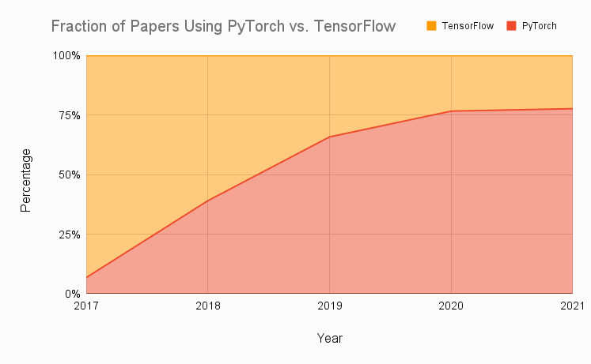
Technical pre-requisites
Framework of choice will be PyTorch! (not Tensorflow, not Keras, not MXNet, etc.)
Increasing popularity and preferred to Google’s Tensorflow these days for many reasons.
Learn more, if curious: https://www.assemblyai.com/blog/pytorch-vs-tensorflow-in-2022/

Slide 19
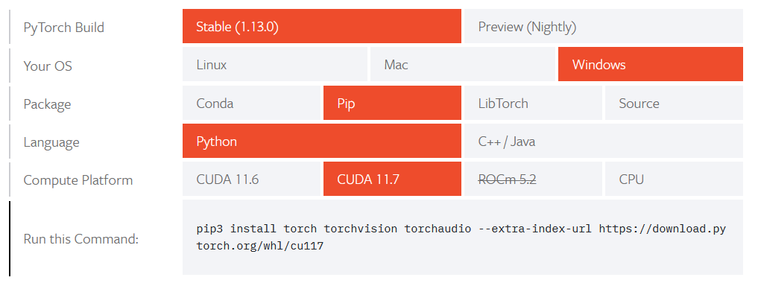
Installing PyTorch and CUDA
Install PyTorch, by getting the right version from https://pytorch.org/get-started/locally/

Slide 20
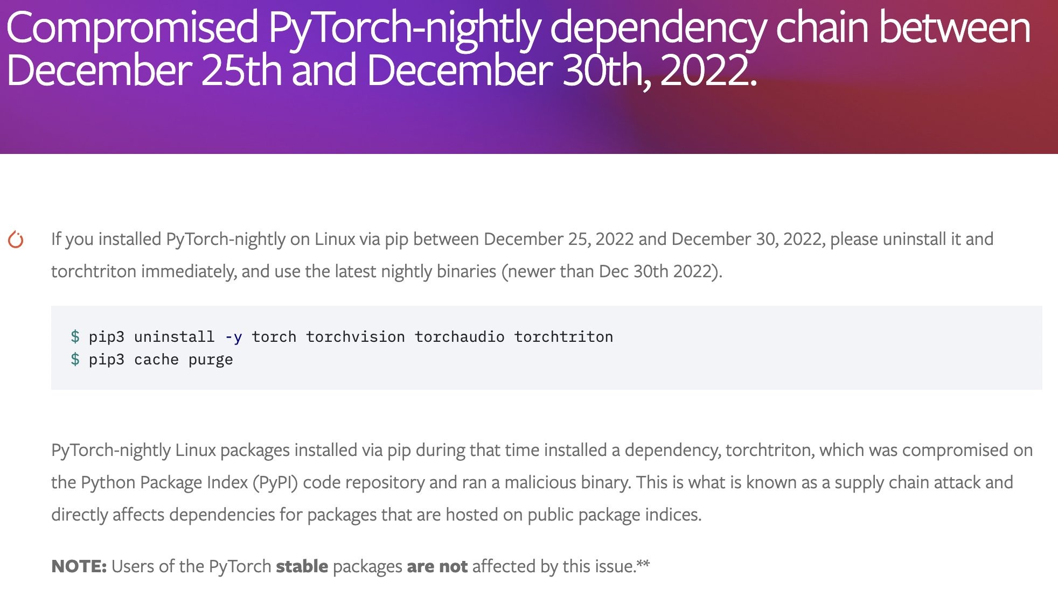
Installing PyTorch and CUDA

Slide 21
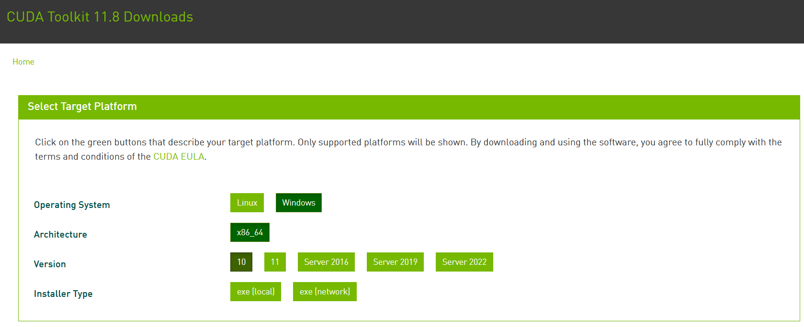
Installing PyTorch and CUDA
Check if your GPU is in the list of acceptable GPUs. https://developer.nvidia.com/cuda-gpus
If so, install CUDA (check version number matches PyTorch install!) https://developer.nvidia.com/cuda-downloads

Slide 22
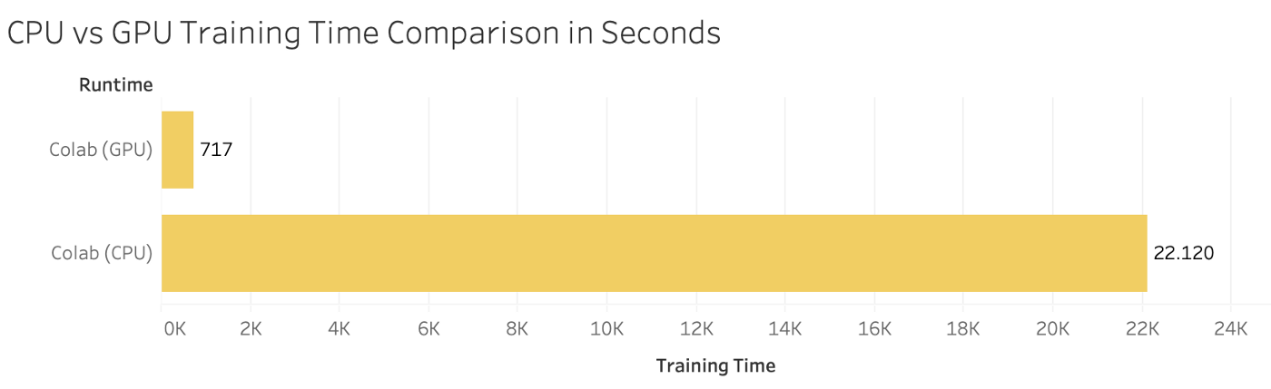

Installing PyTorch and CUDA
GPU not in the list of CUDA-enabled GPUs? Most notebooks can still run on CPU (but they might take significantly longer).
Always the option of using Google Colab, or create an education account on AWS.

Slide 23
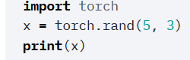
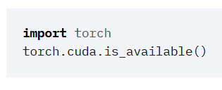
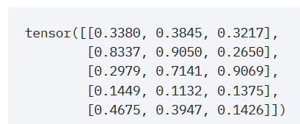
Checking your PyTorch and CUDA install
Hello World for PyTorch: to check you have PyTorch installed correctly. The code below should run and display a tensor.
Hello World for CUDA: to check you have correctly installed CUDA on top of PyTorch. The code below should print True, as the output of torch.cuda.is_available()

Slide 24

A quick word about PyTorch 2.0
PyTorch 2.0 has been announced end of 2022 and will have several new features, including
torch.compile(), which allows for faster training,
and the ability to move parts of the PyTorch framework from C++ back into Python.
It will also be cloud-agnostic, open-source.

Slide 25
A quick word about PyTorch 2.0
PyTorch 2.0 is currently still in its experimental phase. Stable PyTorch 2.0 release date is slotted for March 2023.
(Some nightlies releases are available, but I would advise against using them for now!
Allow me to explore it a bit more first and let us discuss it again in Week 13!)

Slide 26
About this week (Week 1)
What are the typical concepts of Machine Learning to be used as a starting point for this course?
What are the different families of problems in Deep Learning?
What is the typical structure of a Deep Learning problem?
What is linear regression and how to implement it?
What is the gradient descent algorithm and how is it used to train Machine Learning models?
What is polynomial regression and how to implement it?
What is regularization and how to implement it in Ridge regression?

Slide 27
About this week (Week 1)
What is overfitting and why is it bad?
What is underfitting and why is it bad?
What is generalization and how to evaluate it?
What is a train-test split and why is it related to generalization?
What is a sigmoid function? What is a logistic function?
How to perform binary classification using a logistic regressor and how is it related to linear regression?

Slide 28
About this week (Week 1)
What are Neural Networks and how do they relate to the biology of a human brain?
What is a Neuron in a Neural Network and how does it relate to linear/logistic regression?
What is the difference between a shallow and a deep neural network?
How to implement a shallow Neural Network manually and define a forward propagation method for it?
How to train a shallow Neural Network using backpropagation? How to define backward propagation and trainer functions?

Slide 29
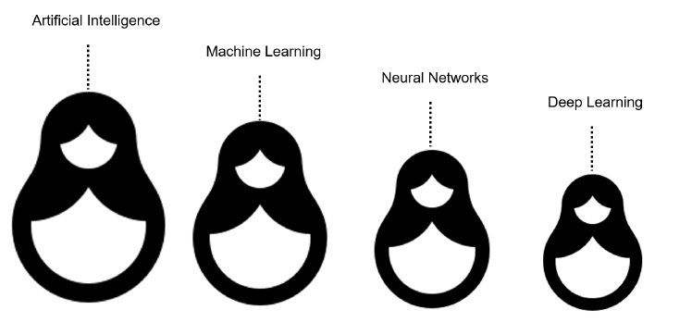
What is AI/ML/NN/DL?
Artificial intelligence
Machine Learning
Neural Networks
Deep Learning
Definition (Artificial Intelligence):
“In Computer Science, Artificial Intelligence (AI) refers to the theory and development of computer systems capable to perform cognitive tasks that normally require human intelligence, such as visual perception, speech recognition, decision-making, and translation between languages.”

Slide 30
What is AI/ML/NN/DL?
Conventional programming
Definition (Machine Learning):
In Computer Science, Machine Learning (ML) refers to the field of study that describes techniques and algorithms that give computers the ability to learn without being explicitly programmed.
Some implementations of machine learning may rely on data and neural networks.
- Arthur Samuel (1959).
Input (Given)
Function
(Created)
Output
(Obtained)
VS.
Machine Learning
Input (Available)
Function
(?)
Output
(Available)

Slide 31
What is AI/ML/NN/DL?
What we have done in programming so far was to design functions,
which would do specific operations,
and return outputs,
for any input we could give it.
But sometimes, we can encounter problems where
we can easily find inputs and expected outputs,
but the function to be coded is not simple to figure out.
E.g., what animal is in the picture?
Input (Given)
Function
(Created)
Output
(Obtained)
Input (Available)
Function
(?)
Output
(Available)

Slide 32

What is AI/ML/NN/DL?
E.g., what animal is in the picture?
Typical problem in Computer Vision, called Image Recognition.
Input x (available)
Function f
(?)
Output y = f(x)
(available)
It’s a cat!

Slide 33
What is AI/ML/NN/DL?
E.g., what animal is in the picture?
Typical problem in Computer Vision, called Image Recognition.
Input x (available)
Function f
(?)
Output y = f(x)
(available)
Very easy for a human…
But, how would we do it with a computer?
It’s a cat!

Slide 34
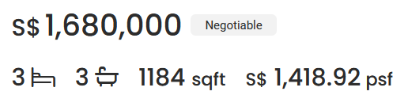
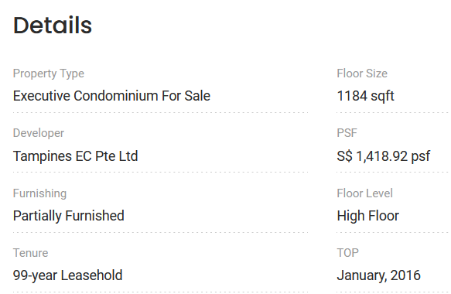

What is AI/ML/NN/DL?
Other scenarios of difficult functions have to do with tasks where there is no easy closed-form expression connecting inputs to outputs.
E.g., what is a good selling price for my appartment?
Guessing the selling price of an appartment based on its parameters (size, location, etc.) and previous sales.

Slide 35

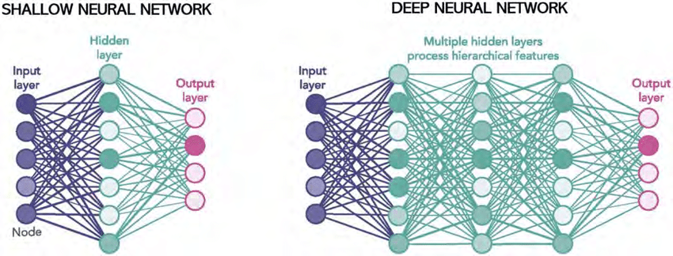
What is AI/ML/NN/DL?
Definition (Neural Networks):
Neural Networks (NNs) are computing systems inspired by the biological neural networks that constitute animal brains.
NNs are based on a collection of connected units or nodes called artificial neurons, which loosely model the neurons in a biological brain.

Slide 36
What is AI/ML/NN/DL?
Definition (Neural Networks):
Neural Networks (NNs) are computing systems inspired by the biological neural networks that constitute animal brains.
NNs are based on a collection of connected units or nodes called artificial neurons, which loosely model the neurons in a biological brain.
Each connection, like the synapses in a biological brain, can transmit a signal to other neurons, therefore processing any information given as inputs to produce a final signal as output.

Slide 37
What is AI/ML/NN/DL?
Definition (Deep Learning):
Deep Learning (DL) is a subfield of machine learning, and deep neural networks make up the backbone of deep learning algorithms.
The number of node layers, or depth, of neural networks is what distinguishes a shallow neural network from a deep neural network, which must have more than three.

Slide 38
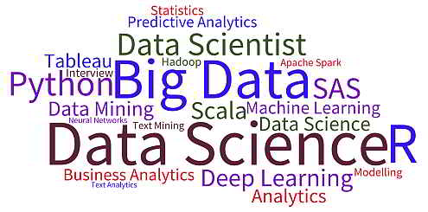
What is AI/ML/NN/DL?
Artificial intelligence
Machine Learning
Neural Networks
Deep Learning

Slide 39
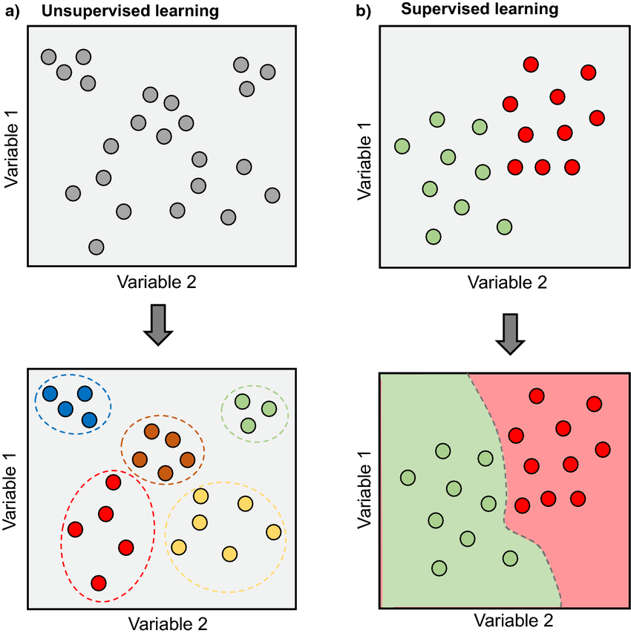
Supervised vs Unsupervised Learning
Definition (Supervised vs. Unsupervised Learning):
Supervised and Unsupervised Learning are the two techniques of machine learning.
The main difference is the need for labelled training data:
Supervised machine learning relies on labelled input and output data to learn and make predictions,
while unsupervised learning does not require labelled data.

Slide 40

Supervised Learning Examples
Examples of supervised learning: spam detection, text classification, predicting the stock market, etc.

Slide 41
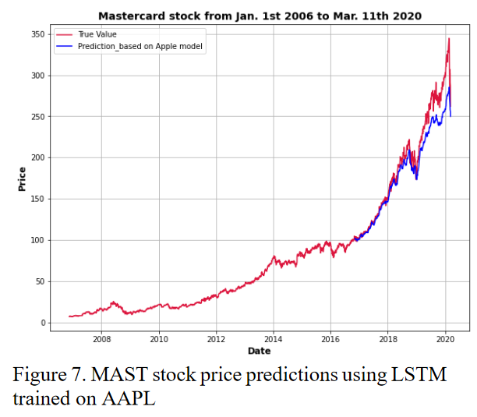
Supervised Learning Examples
Examples of supervised learning: spam detection, text classification, predicting the stock market, etc.

Slide 42
Regression vs. Classification
Definition (Regression):
Regression models are used to identify the relationships between the input and output variables.
Regression algorithms are used to predict continuous values such as price, salary, age, etc.
In regression, the outputs are often continuous numerical values.

Slide 43
Regression vs. Classification (Supervised)
Definition (Classification):
Classification models are used to divide the samples in the dataset into different classes.
Classification algorithms are then used to predict/classify discrete values, such as Male or Female, True or False, Spam or Not Spam, etc.
In Classification, the outputs are discrete or categorical values.

Slide 44
Supervised Learning Examples
Example: predicting the market.
Question: is it a regression or a classification task?

Slide 45
Supervised Learning Examples
Example: predicting the market.
Question: is it a regression or a classification task?
Depends.
If the output we are predicting is the value of the stock in the future, then probably regression.

Slide 46
Supervised Learning Examples
Example: predicting the market.
Question: is it a regression or a classification task?
Depends.
If the output we are predicting is the value of the stock in the future, then probably regression.
If the plan is to predict whether we should buy, sell or wait, then probably classification.

Slide 47
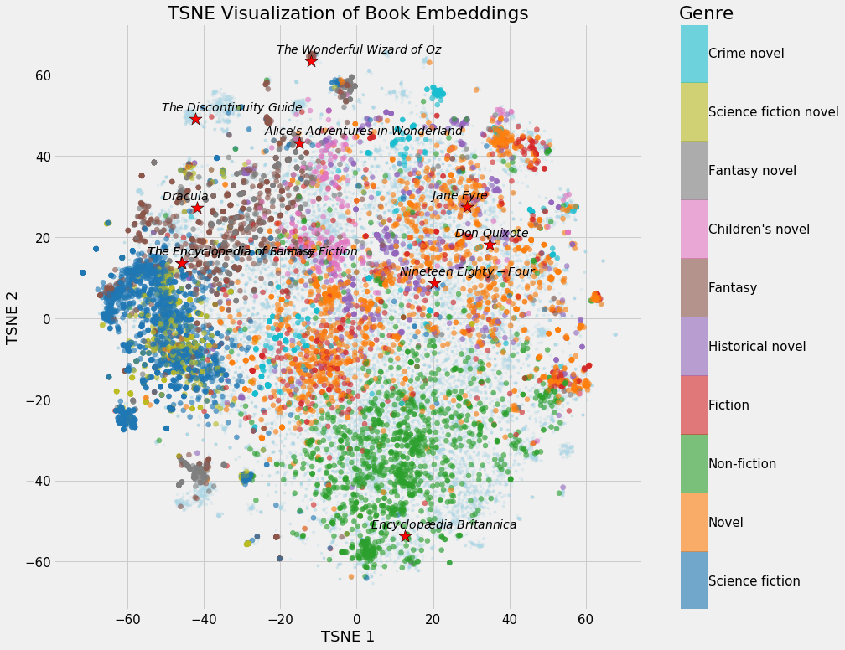
Unsupervised Learning Examples
Examples of unsupervised learning: clustering customers based on their behaviors, segmenting images, and identifying topics in a document.

Slide 48
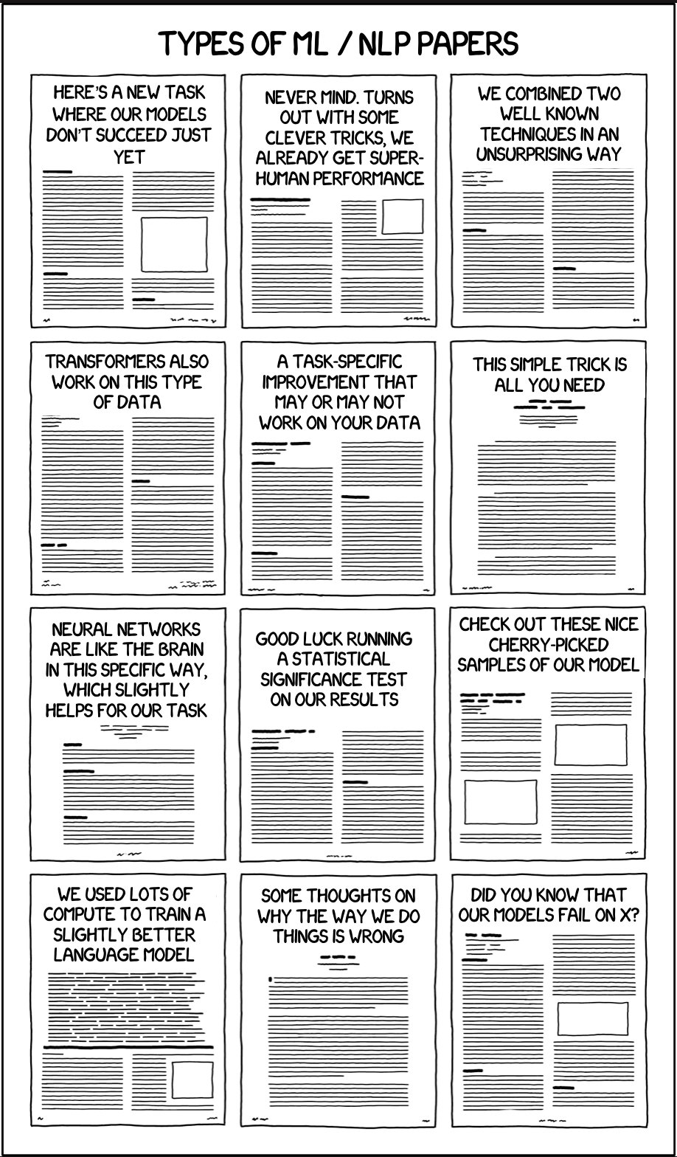
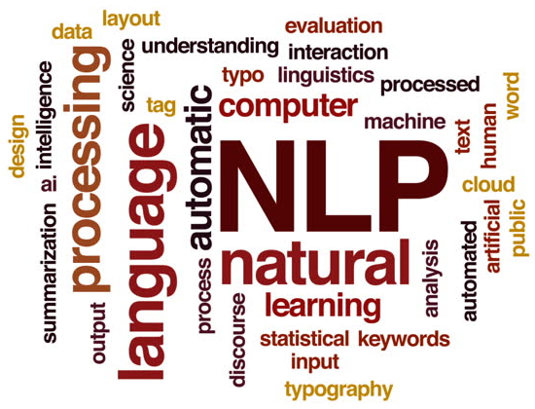
Unsupervised Learning Examples
Identify topics that seem to appear in those papers and their prominence
Examples of unsupervised learning: clustering customers based on their behaviors, segmenting images, and identifying topics in a document.

Slide 49
Clustering vs. Association (Unsupervised)
Definition (Clustering vs. Association):
Unsupervised learning can be used for two types of problems: Clustering and Association.
The main difference is that
clustering groups data based on similarity,
while association looks for relationships between variables.

Slide 50
Clustering vs. Association (Unsupervised)
Examples of clustering:
Group customers into clusters based on the similarities in their purchasing behaviours, such as their spending habits or types of products they like.
Group the catalogue of movies available on Netflix and identify what movies have in common, so you can later recommend a movie to a user based on what he/she has seen before.

Slide 51
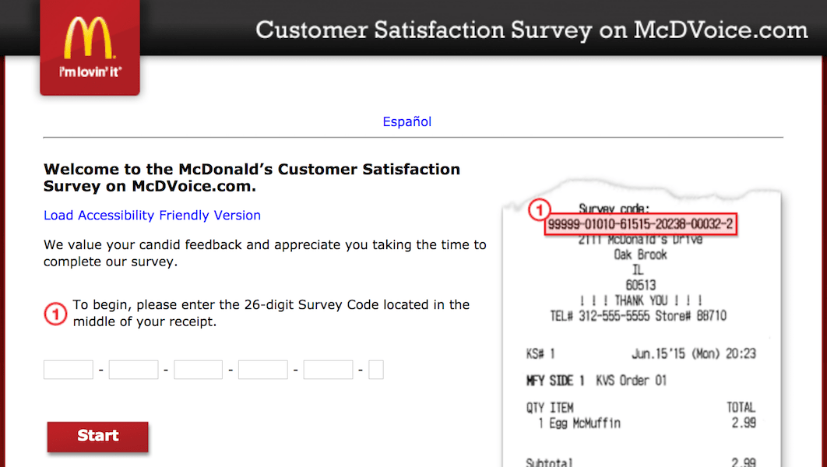

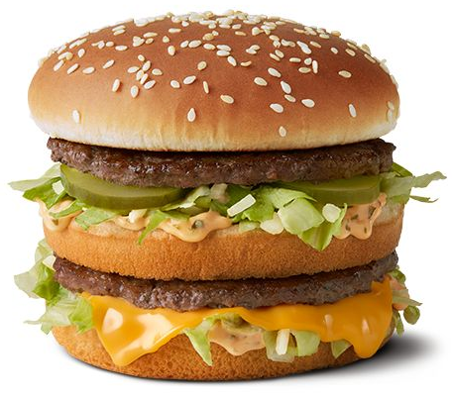

Clustering vs. Association (Unsupervised)
Example of association:
Finding the relationship between customer buying behaviors and customer satisfaction.
Association can be used to understand how changes in customer behavior impacts customer satisfaction, such as if buying a certain product increases customer satisfaction (or the opposite).

Slide 52
Deep Learning and Supervised/Unsupervised
While it is possible to use Deep Learning models and Neural Networks to perform both Supervised and Unsupervised tasks…
The vast majority of DL/NN tasks fall in the category of supervised learning.
(And we will therefore mostly focus on that)

Slide 53
Elements of a ML problem
Definition (Elements of a Machine Learning problem):
Machine learning problems should be well-defined, i.e. the following elements must be clearly identified:
Task (T) at hand,
Inputs (I) and Ouputs (O),
Model (M) definition and its trainable parameters (P),
Loss (L) function to measure the performance on said task and dataset.

Slide 54
Elements of a ML problem
In the example on the right…
Task (T) at hand:
Predict price of an apartment based on the apartment features.
Using a dataset consisting of previously seen appartments to learn the selling prices of apartments.
It is therefore a supervised regression task.

Slide 55
Elements of a ML problem
In the example on the right…
Inputs (I) and Ouputs (O):
Inputs will be a list of apartment features (e.g. number of bathrooms, number of bedrooms, surface size, etc.).
Output will be the selling price in SGD or surface price in SGD per sqft.

Slide 56
Elements of a ML problem
In the example on the right…
Model (M) definition and its trainable parameters (P):
Could be a linear or polynomial regression model (to be discussed this week). Or a neural network of some sort. Or even something else (check your ML course!)
Loss (L) function to measure the performance on said task and dataset:
To be discussed later, as this might depend on the model used.

Slide 57
Our first toy example
Our first toy example: simplified version of the apartment price prediction.
Task (T) at hand:
Predict price of an apartment based on the apartment features.
We will generate a “fake” dataset consisting of appartments with features and selling prices.
Supervised regression task.

Slide 58
Our first toy example
Our first toy example: simplified version of the apartment price prediction.
Inputs (I) and Ouputs (O):
Inputs will be a list of apartment features, which here will only consist of the surface of the apartment, in square meters (sqm).
Output will be the selling price in millions of SGD (mSGD).

Slide 59
Our first toy example (mock dataset)
Have a look at Week 1, Notebook 1.
We will create a dataset, which uses surfaces as inputs, with values drawn randomly between 40 and 150 sqm.
We will assume that the price is randomly generated, using a uniform distribution, with
average 100000 + 14373 times the surface in sqm,
and a "variance" of +/- 10% around the average value.

Slide 60
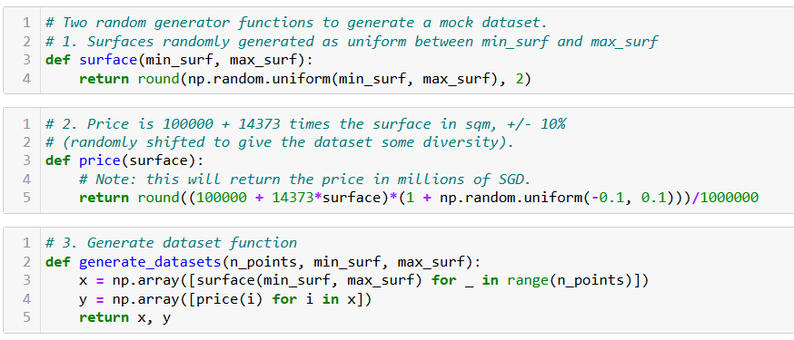
Our first toy example (mock dataset)

Slide 61
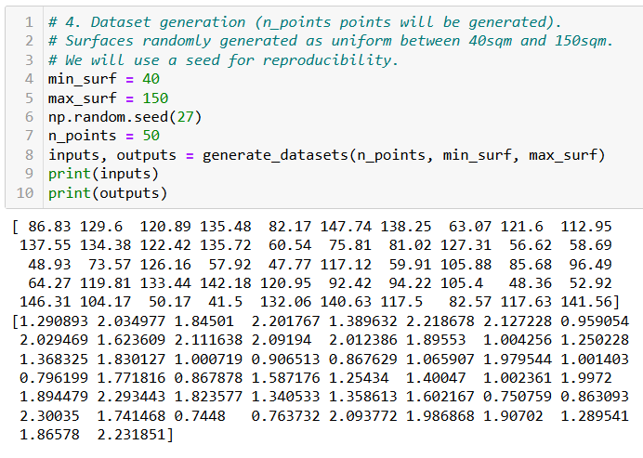
Our first toy example (mock dataset)

Slide 62
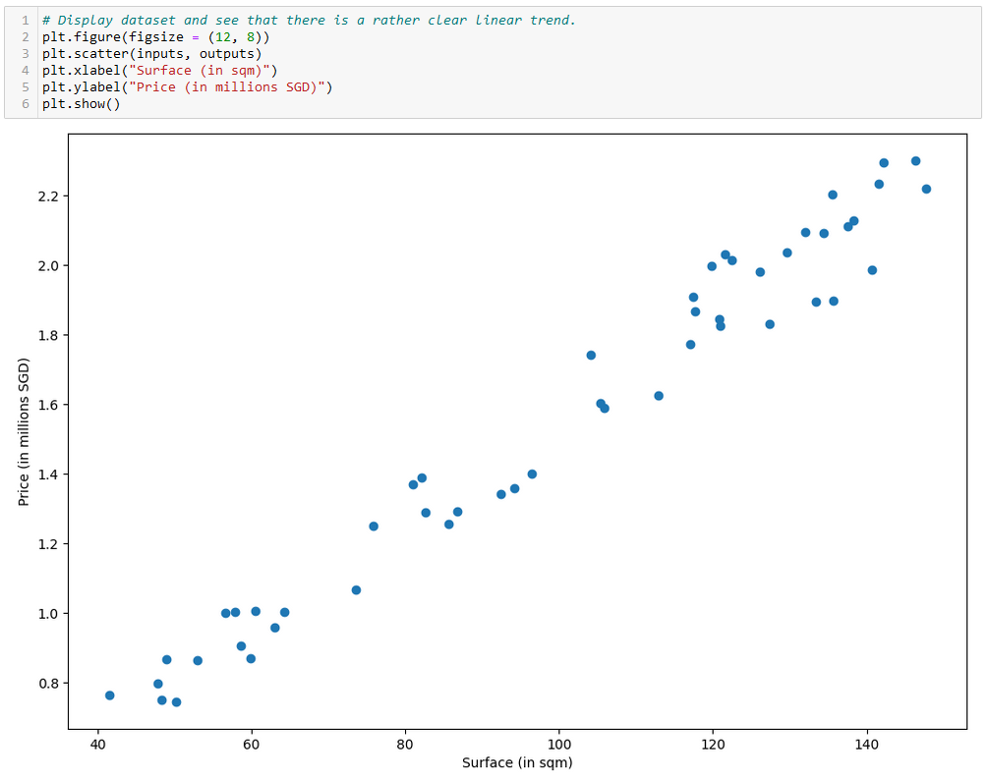

Slide 63
Our first toy example
Our first toy example: simplified version of the apartment price prediction.
Model (M) definition and its trainable parameters (P):
Here, our model will consist of a linear regression model.

Slide 64
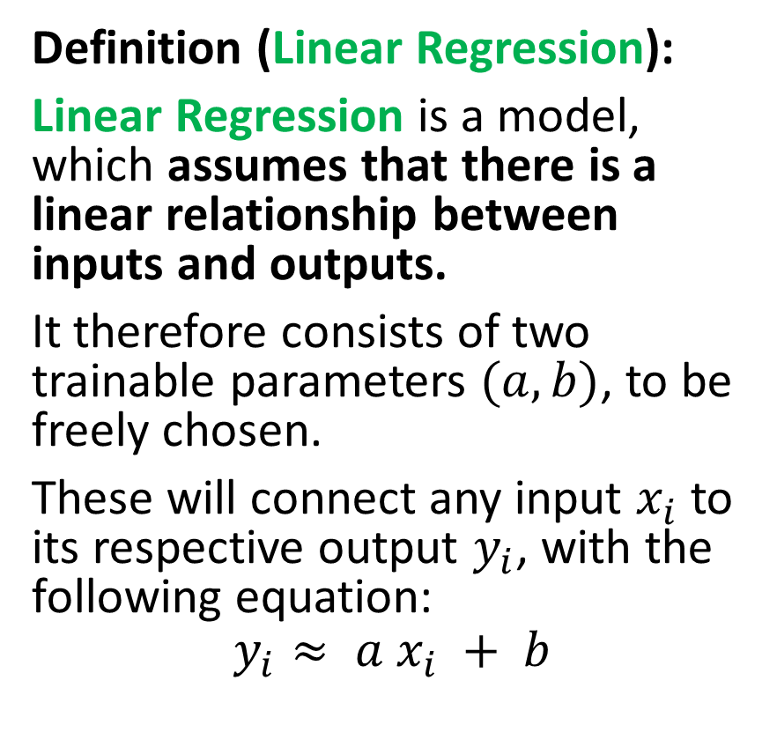
Our first model, the linear regression
Definition (Linear Regression):
Linear Regression is a model, which assumes that there is a linear relationship between inputs and outputs.
It therefore consists of two trainable parameters $(a, b)$, to be freely chosen.
These will connect any input $x_{i}$ to its respective output $y_{i}$, with the following equation:
$$y_{i}≈ a x_{i} + b$$

Slide 65
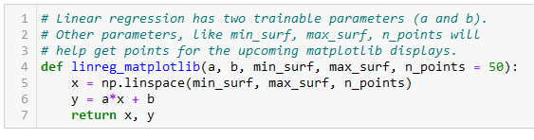
Our first model, the linear regression
Definition (Linear Regression):
Linear Regression is a model, which assumes that there is a linear relationship between inputs and outputs.
It therefore consists of two trainable parameters $(a, b)$, to be freely chosen.
These will connect any input $x_{i}$ to its respective output $y_{i}$, with the following equation:
$$y_{i}≈ a x_{i} + b$$

Slide 66
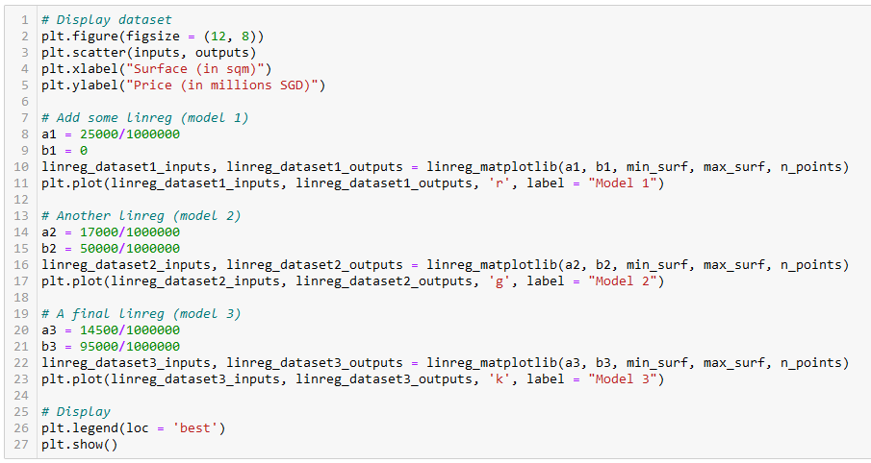
Let us try different values of (a, b)
Model 1
Model 2
Model 3

Slide 67
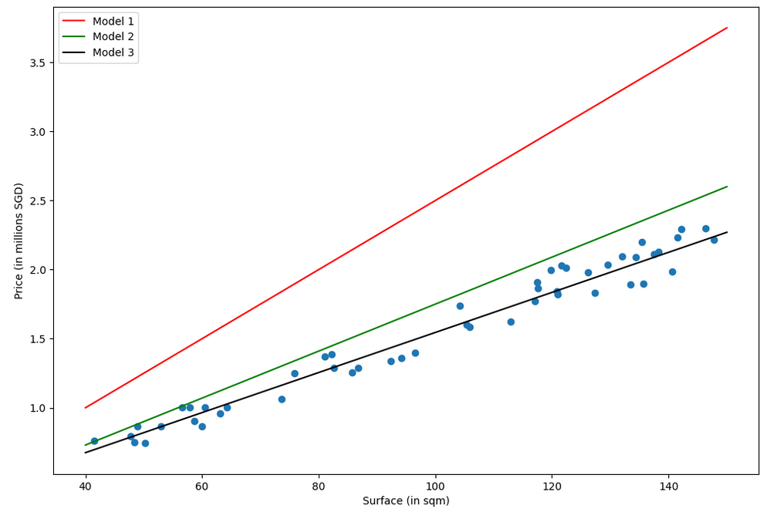
Which model is best in your opinion? (red, green or black)
Why is one better than another?

Slide 68
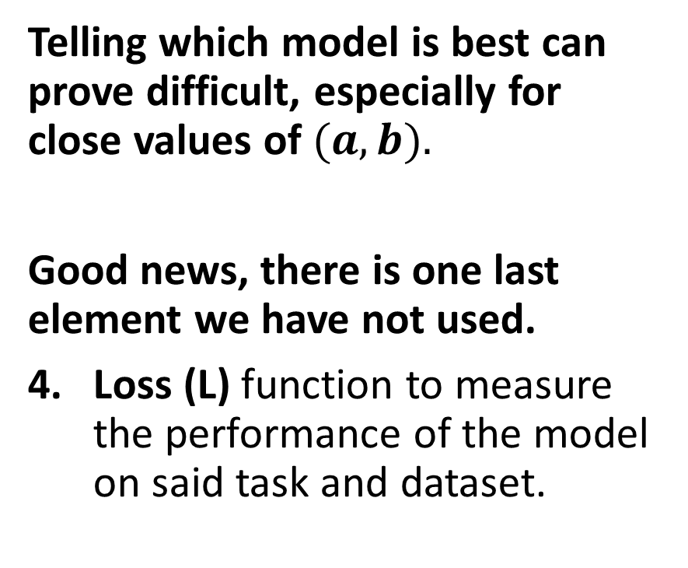
The need for a loss function
Which model is best in your opinion? (red, green or black)
Why is one better than another?
Telling which model is best can prove difficult, especially for close values of $(a, b).$
Good news, there is one last element we have not used.
Loss (L) function to measure the performance of the model on said task and dataset.

Slide 69
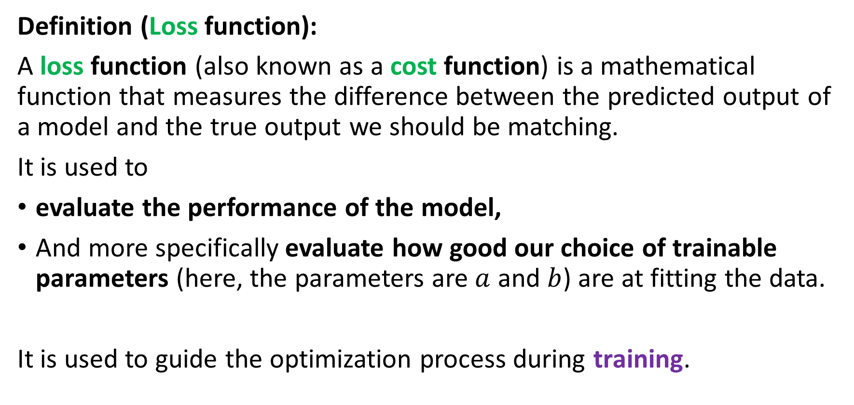
The need for a loss function
Definition (Loss function):
A loss function (also known as a cost function) is a mathematical function that measures the difference between the predicted output of a model and the true output we should be matching.
It is used to
evaluate the performance of the model,
And more specifically evaluate how good our choice of trainable parameters (here, the parameters are $a$ and $b$) are at fitting the data.
It is used to guide the optimization process during training.

Slide 70
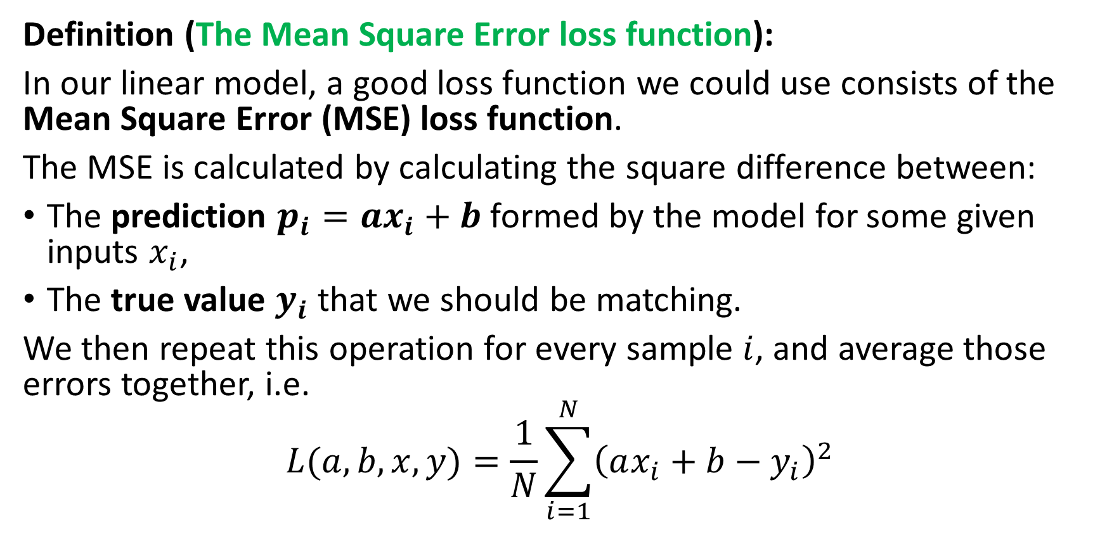
The need for a loss function
Definition (The Mean Square Error loss function):
In our linear model, a good loss function we could use consists of the Mean Square Error (MSE) loss function.
The MSE is calculated by calculating the square difference between:
The prediction $p_{i}=ax_{i}+b$formed by the model for some given inputs $x_{i}$,
The true value $y_{i}$ that we should be matching.
We then repeat this operation for every sample $i$, and average those errors together, i.e.
$$L(a, b,x, y)=\frac{1}{N}\sum_{i=1}^{N}{{\left(ax_{i}+b−y_{i}\right)}^{2}}$$

Slide 71
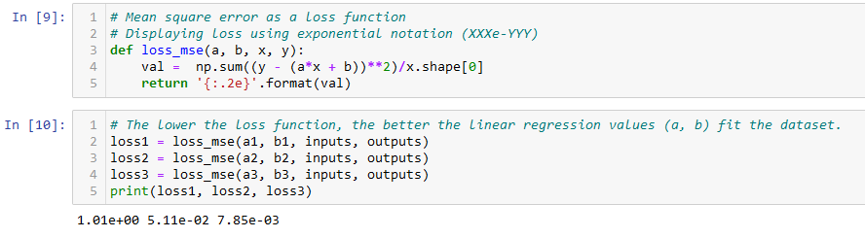
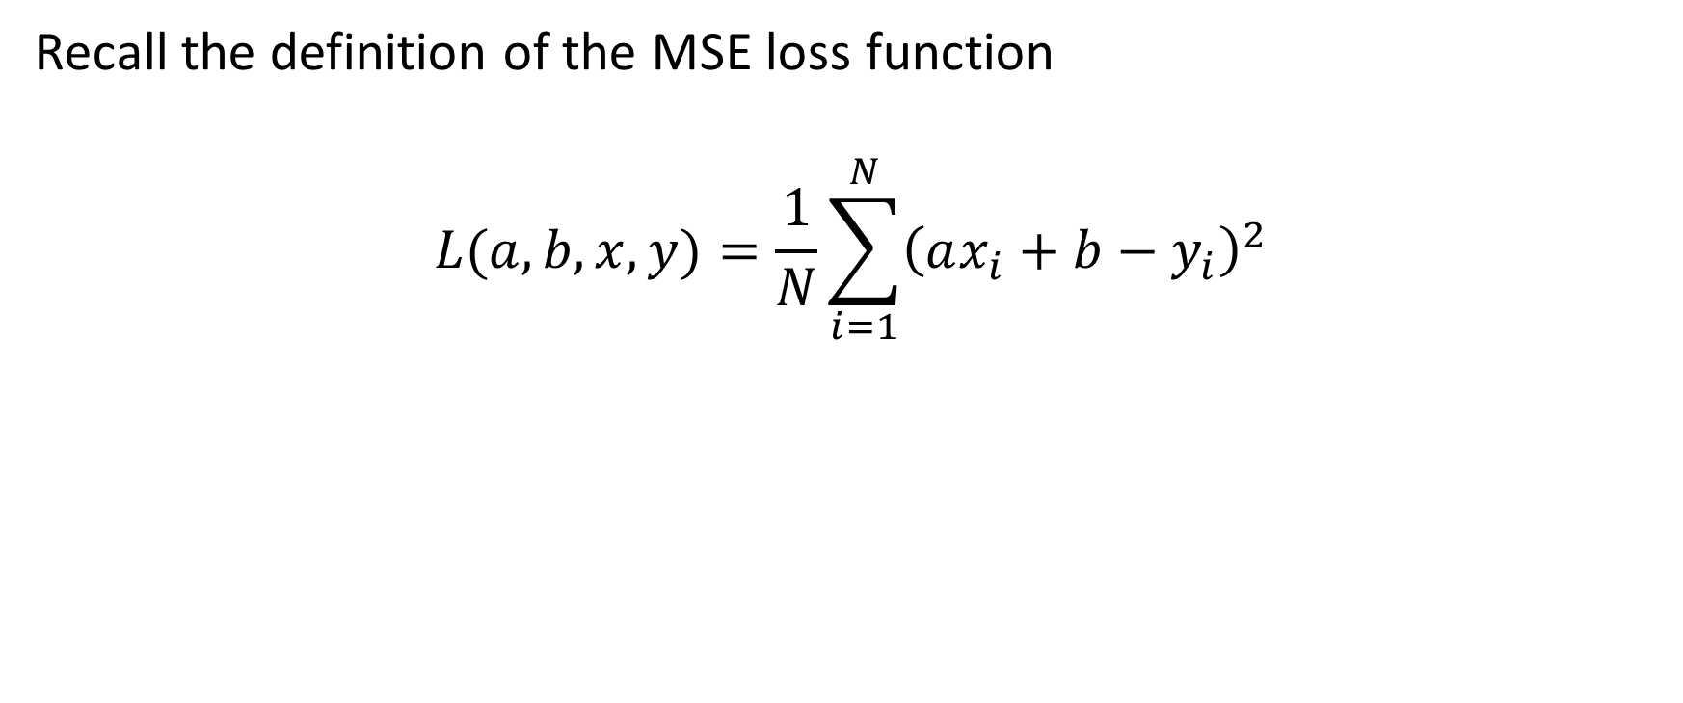
The need for a loss function
Recall the definition of the MSE loss function
$$L(a, b,x, y)=\frac{1}{N}\sum_{i=1}^{N}{{\left(ax_{i}+b−y_{i}\right)}^{2}}$$

Slide 72
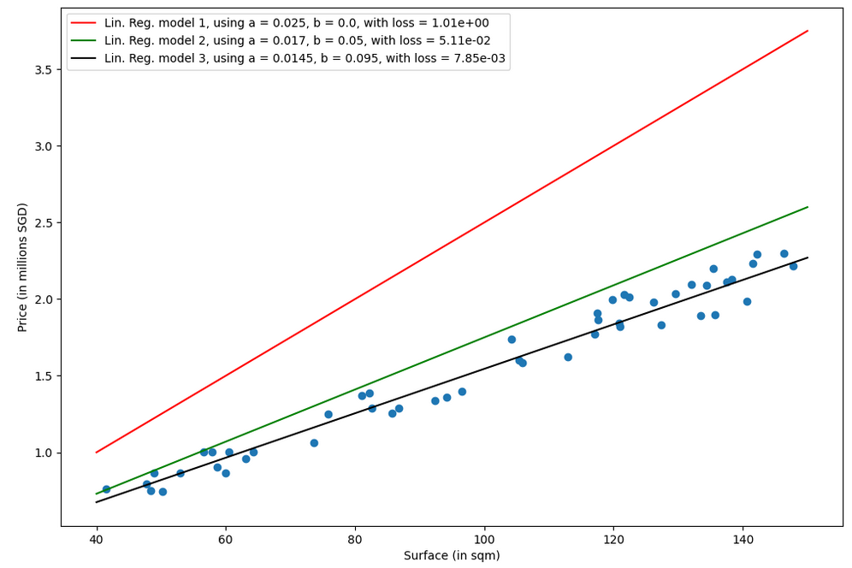

Slide 73
Training a model
Definition (Training a model):
Training a model consists of finding the best values for the trainable parameters of the chosen model, for the given task and dataset.
The goal of training is to find the set of model parameters that minimize the loss function. Once a minimal value is obtained on the loss function, then we can claim that the “optimal” trainable parameters have been found (or in other word, the model has been trained).

Slide 74
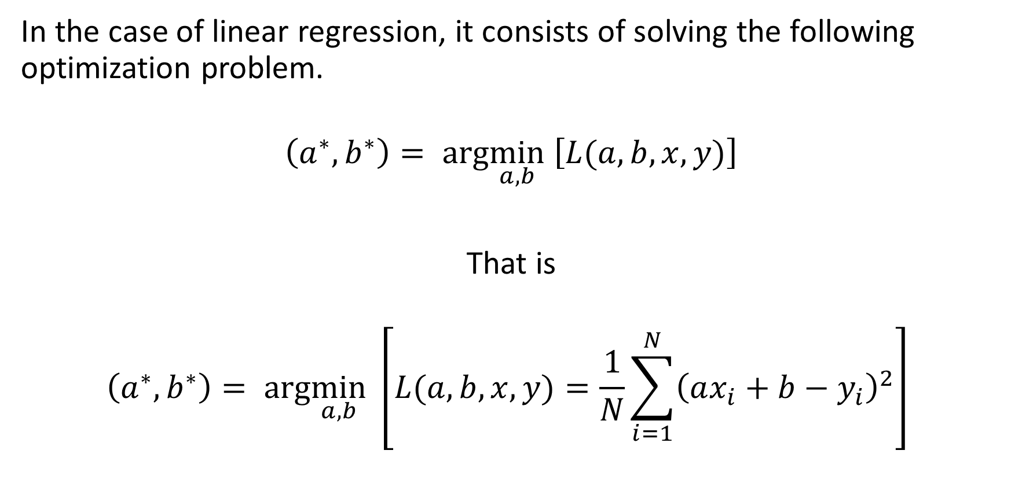
Training a linear regression model
In the case of linear regression, it consists of solving the following optimization problem.
$$\left(a^{∗},b^{∗}\right)= arg\min_{a,b} \left[L(a, b,x, y)\right]$$
That is
$$\left(a^{∗},b^{∗}\right)= arg\min_{a,b} \left[L(a, b,x, y)=\frac{1}{N}\sum_{i=1}^{N}{{\left(ax_{i}+b−y_{i}\right)}^{2}}\right]$$

Slide 75
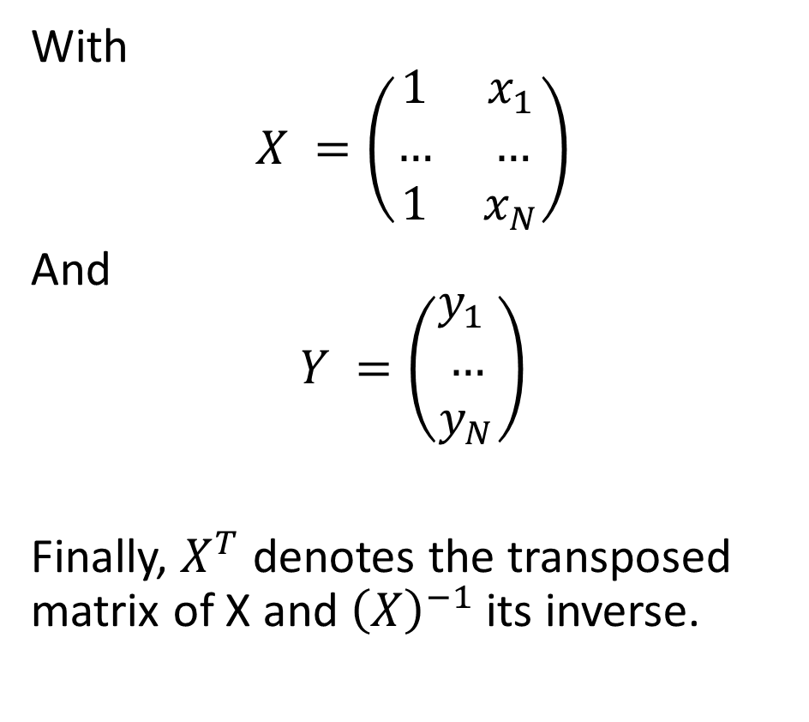
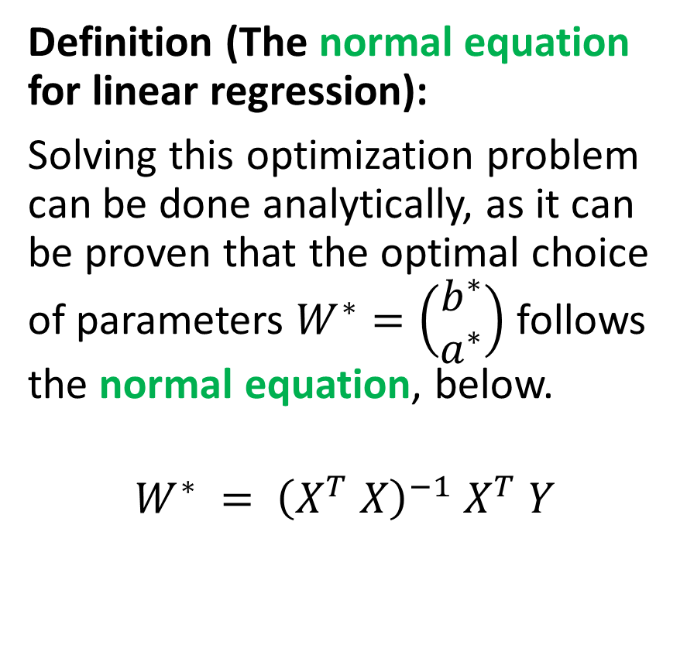
Training a linear regression model
Definition (The normal equation for linear regression):
Solving this optimization problem can be done analytically, as it can be proven that the optimal choice of parameters $W^{∗}=\left(\begin{matrix}b^{∗} \\ a^{∗}\end{matrix}\right)$ follows the normal equation, below.
$$W^{∗} = {\left(X^{T} X\right)}^{−1} X^{T} Y$$
With
$$X =\left(\begin{matrix}1 & x_{1} \\ … & … \\ 1 & x_{N}\end{matrix}\right)$$
And
$$Y =\left(\begin{matrix}y_{1} \\ … \\ y_{N}\end{matrix}\right)$$
Finally, $X^{T}$ denotes the transposed matrix of X and ${\left(X\right)}^{−1}$its inverse.

Slide 76
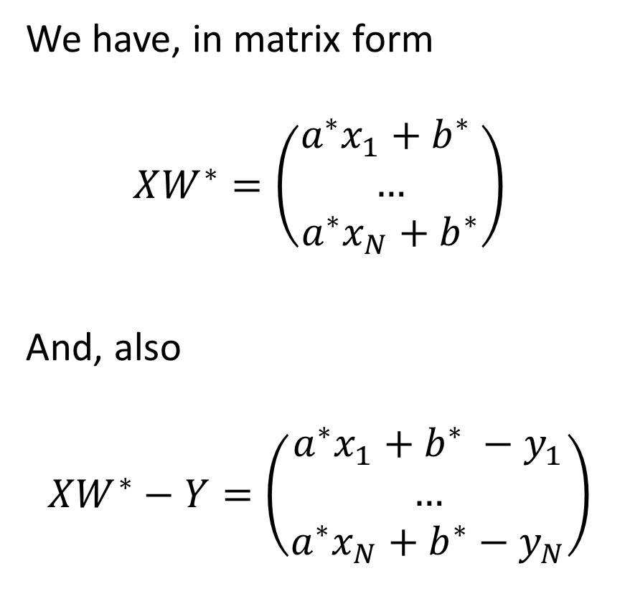
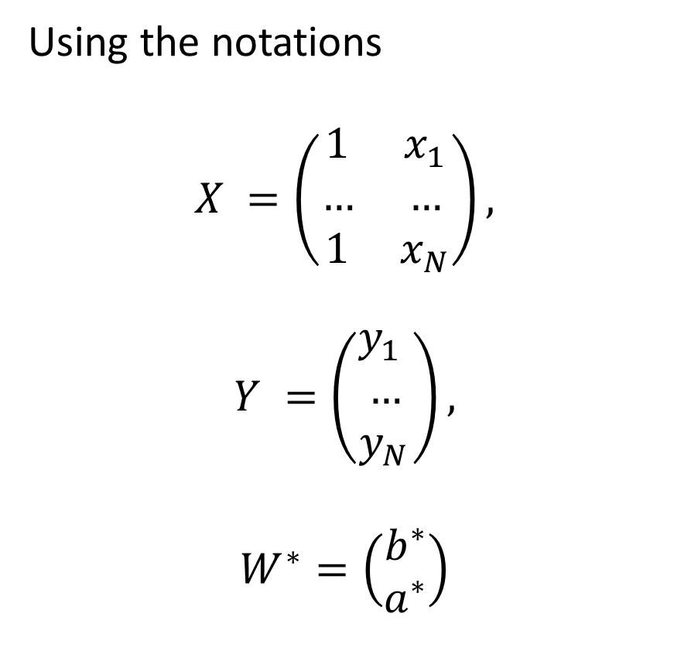
Proof of the Normal Equation
Using the notations
$$X =\left(\begin{matrix}1 & x_{1} \\ … & … \\ 1 & x_{N}\end{matrix}\right),$$
$$Y =\left(\begin{matrix}y_{1} \\ … \\ y_{N}\end{matrix}\right),$$
$$W^{∗}=\left(\begin{matrix}b^{∗} \\ a^{∗}\end{matrix}\right)$$
We have, in matrix form
$$XW^{∗}=\left(\begin{matrix}a^{∗}x_{1}+b^{∗} \\ … \\ a^{∗}x_{N}+b^{∗}\end{matrix}\right)$$
And, also
$$XW^{∗}−Y=\left(\begin{matrix}a^{∗}x_{1}+b^{∗} −y_{1} \\ … \\ a^{∗}x_{N}+b^{∗}−y_{N}\end{matrix}\right)$$

Slide 77
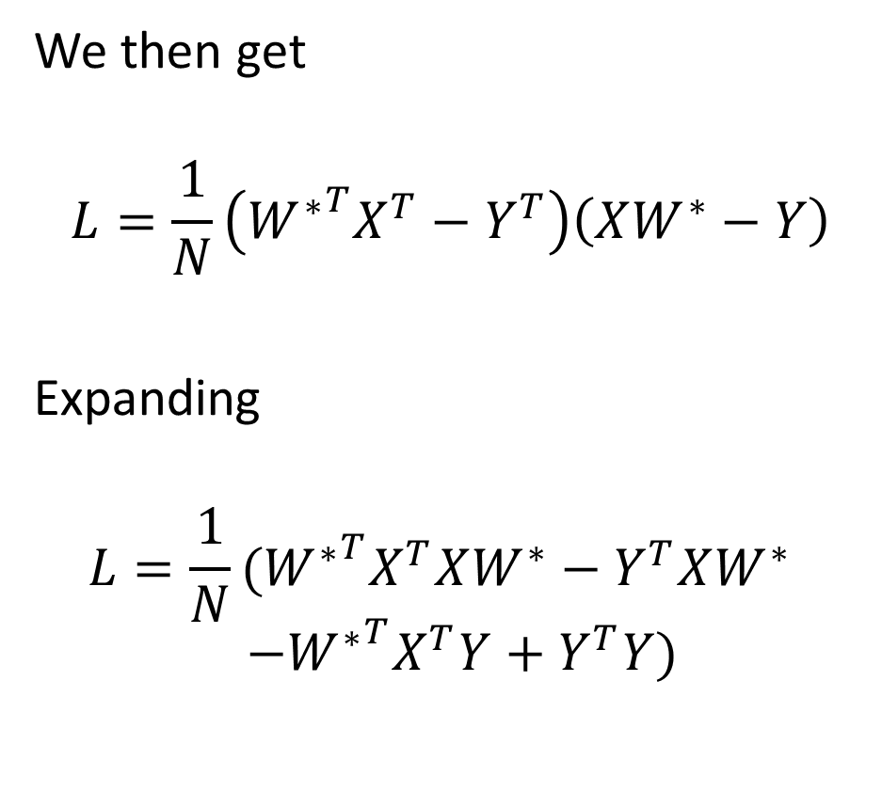
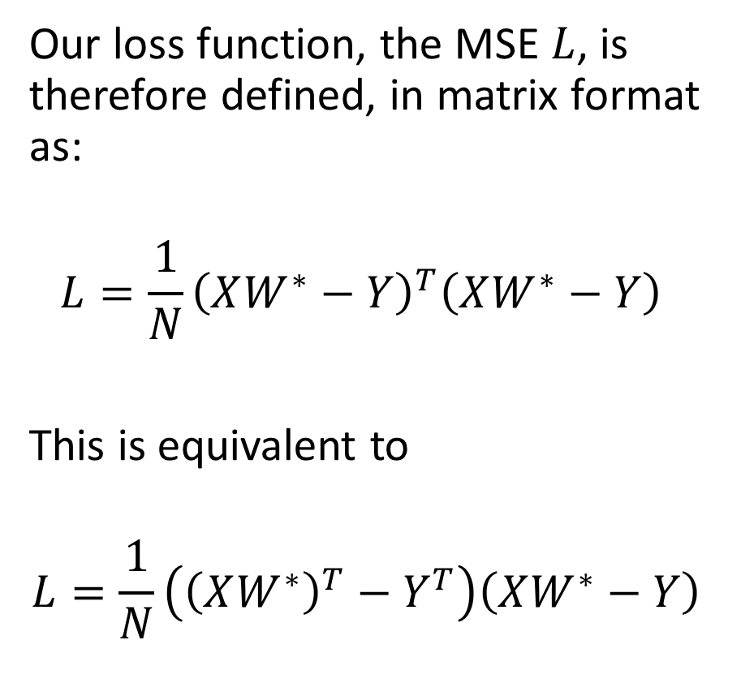
Proof of the Normal Equation
Our loss function, the MSE $L$, is therefore defined, in matrix format as:
$$L=\frac{1}{N}{\left(XW^{∗}−Y\right)}^{T}\left(XW^{∗}−Y\right)$$
This is equivalent to
$$L=\frac{1}{N}\left({\left(XW^{∗}\right)}^{T}−Y^{T}\right)\left(XW^{∗}−Y\right)$$
We then get
$$L=\frac{1}{N}\left({W^{∗}}^{T}X^{T}−Y^{T}\right)\left(XW^{∗}−Y\right)$$
Expanding
$$L=\frac{1}{N}({W^{∗}}^{T}X^{T}XW^{∗}−Y^{T}XW^{∗})$$
$$(−{W^{∗}}^{T}X^{T}Y+Y^{T}Y)$$

Slide 78
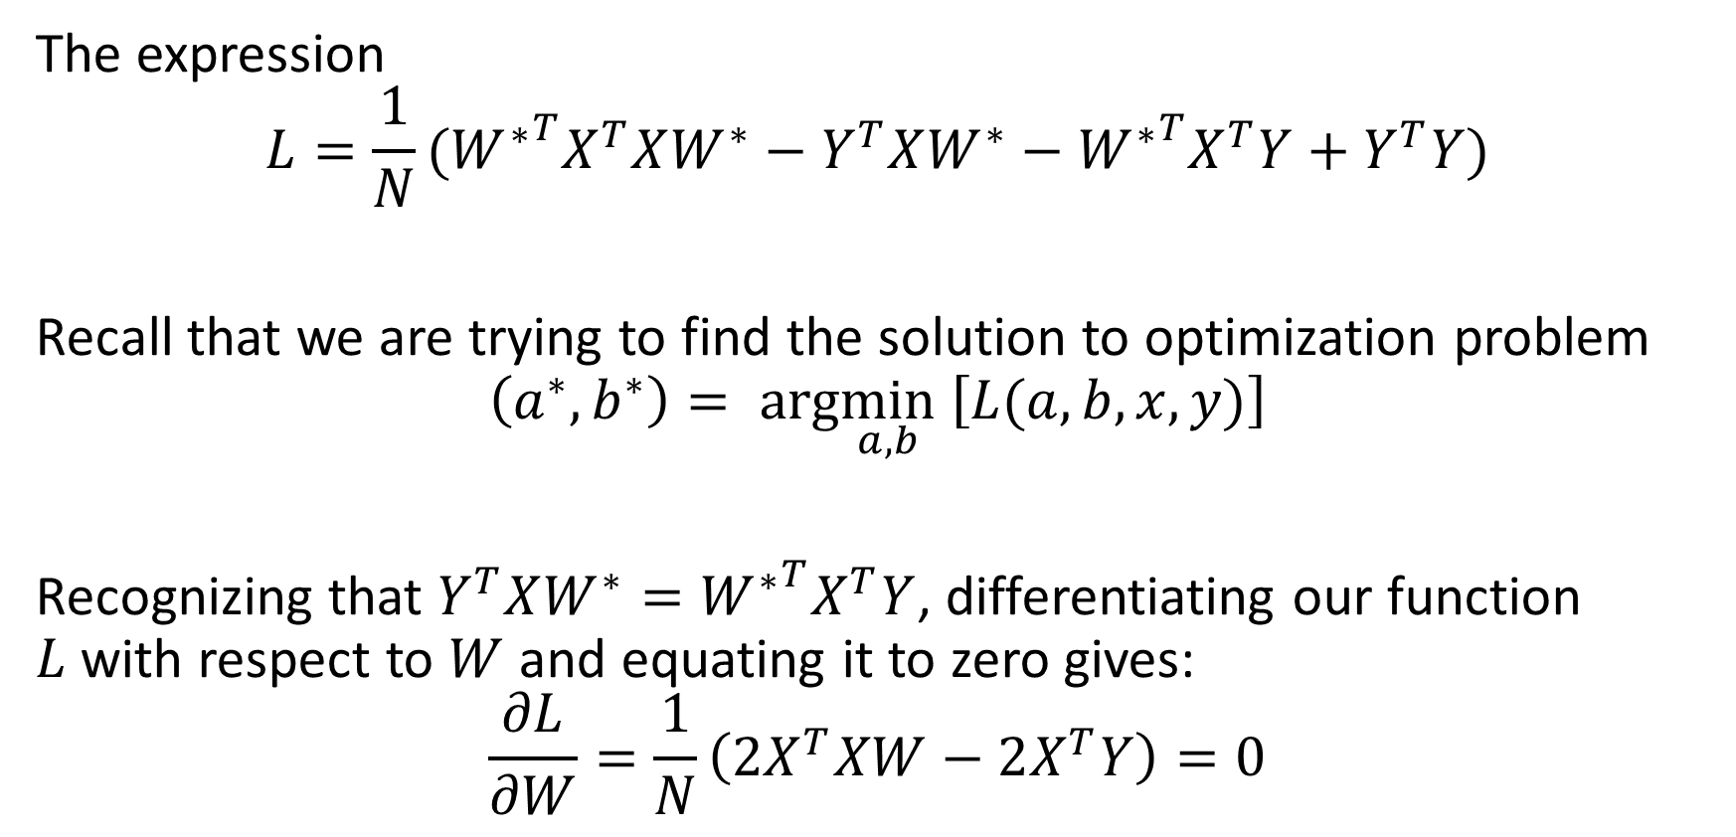
Proof of the Normal Equation
The expression
$$L=\frac{1}{N}({W^{∗}}^{T}X^{T}XW^{∗}−Y^{T}XW^{∗}−{W^{∗}}^{T}X^{T}Y+Y^{T}Y)$$
Recall that we are trying to find the solution to optimization problem
$$\left(a^{∗},b^{∗}\right)= arg\min_{a,b} \left[L(a, b,x, y)\right]$$
Recognizing that $Y^{T}XW^{∗}={W^{∗}}^{T}X^{T}Y$, differentiating our function $L$with respect to $W$ and equating it to zero gives:
$$\frac{∂L}{∂W}=\frac{1}{N}\left({2X}^{T}XW−2X^{T}Y\right)=0$$

Slide 79
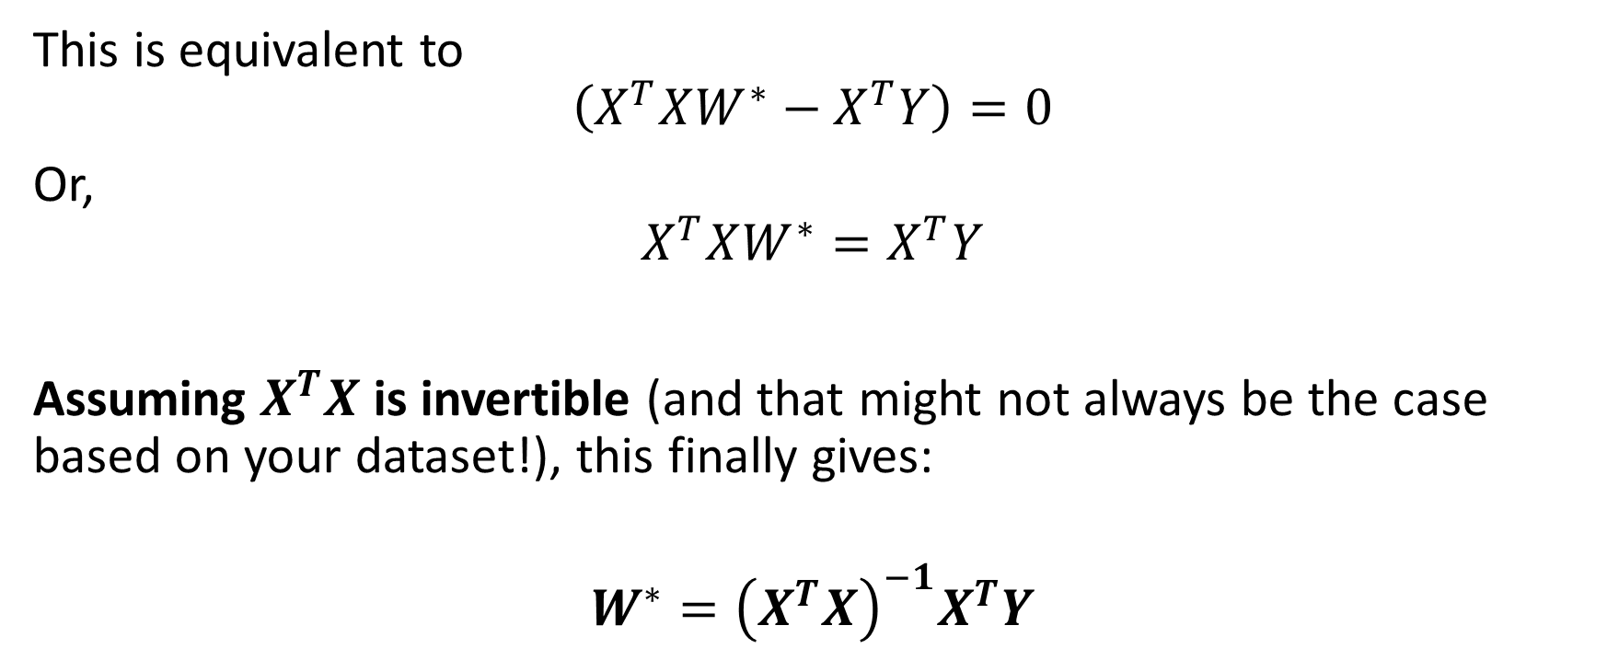
Proof of the Normal Equation
This is equivalent to
$$\left(X^{T}XW^{∗}−X^{T}Y\right)=0$$
Or,
$$X^{T}XW^{∗}=X^{T}Y$$
Assuming $X^{T}X$ is invertible (and that might not always be the case based on your dataset!), this finally gives:
$$W^{∗}={\left(X^{T}X\right)}^{−1}X^{T}Y$$

Slide 80
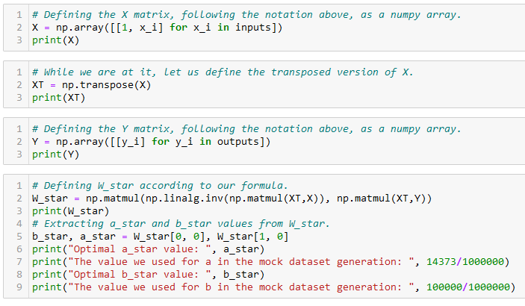
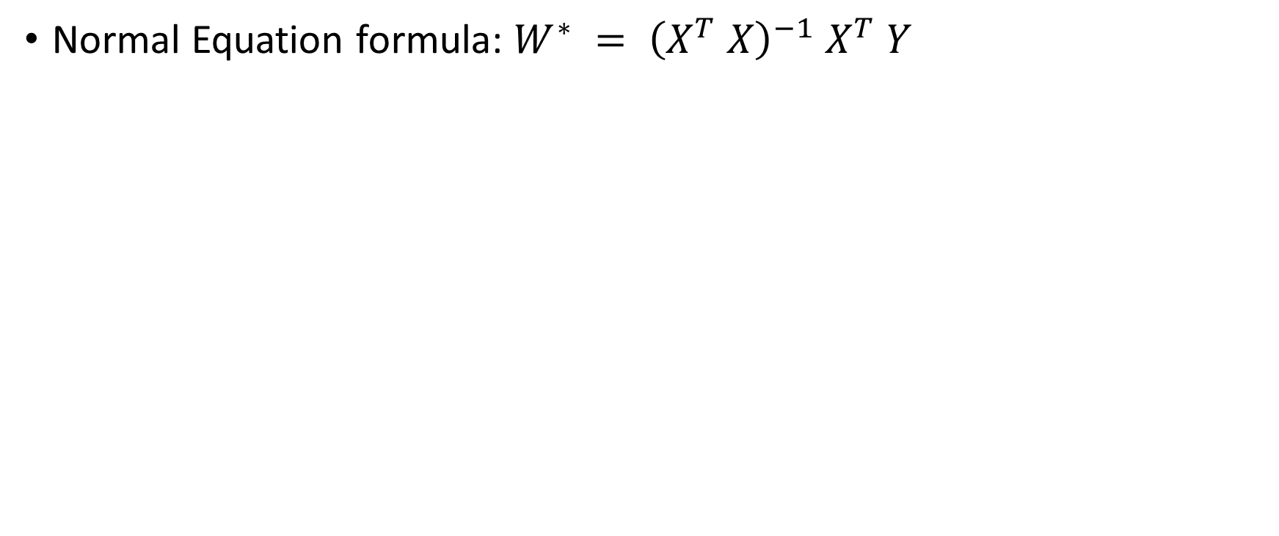
Training a linear regression model
Normal Equation formula: $W^{∗} = {\left(X^{T} X\right)}^{−1} X^{T} Y$

Slide 81
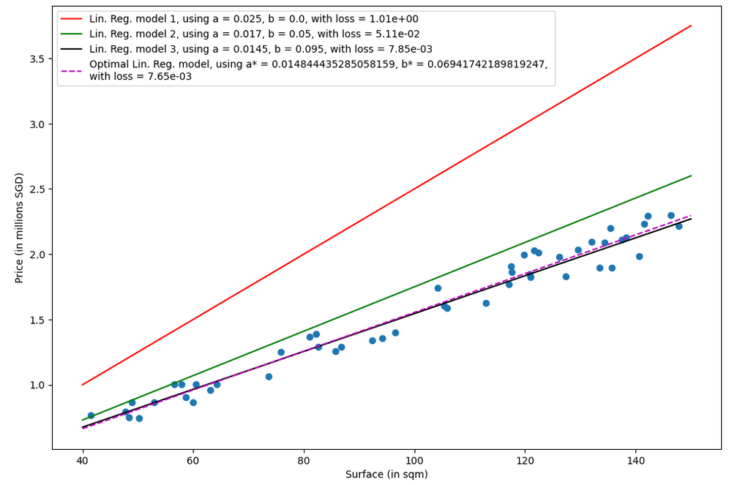

Slide 82
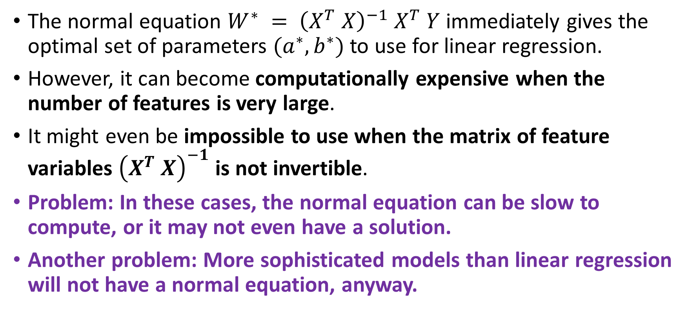
A problem with the normal equation
The normal equation $W^{∗} = {\left(X^{T} X\right)}^{−1} X^{T} Y$immediately gives the optimal set of parameters $(a^{∗}, b^{∗})$to use for linear regression.
However, it can become computationally expensive when the number of features is very large.
It might even be impossible to use when the matrix of feature variables ${\left(X^{T} X\right)}^{−1}$ is not invertible.
Problem: In these cases, the normal equation can be slow to compute, or it may not even have a solution.
Another problem: More sophisticated models than linear regression will not have a normal equation, anyway.

Slide 83
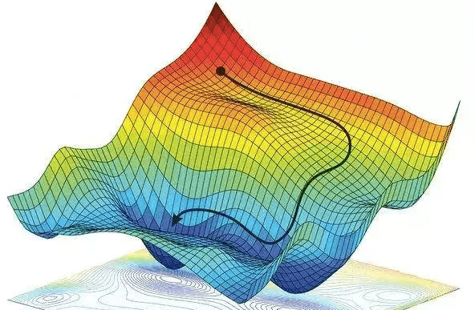
Gradient Descent, to the rescue!
Definition (Gradient Descent):
Gradient Descent (GD) is an iterative algorithm used to solve optimization problems.
It starts with an initial set of parameters.
It then repeatedly updates the parameters in the direction of the negative gradient of the given cost function, until it converges to a local minimum.
Forgot about GD? Have a look at your notes from 10.013 M&A!

Slide 84
Gradient Descent, to the rescue!
Definition (Gradient Descent):
Gradient Descent (GD) is an iterative algorithm used to solve optimization problems.
It starts with an initial set of parameters.
It then repeatedly updates the parameters in the direction of the negative gradient of the given cost function, until it converges to a local minimum.
The normal equation has many problems…
But GD, on the other hand can be used to find the optimal solution even when the normal equation is not applicable.
The main advantage of gradient descent is that it can handle very large datasets and it can also be used for non-linear models.

Slide 85
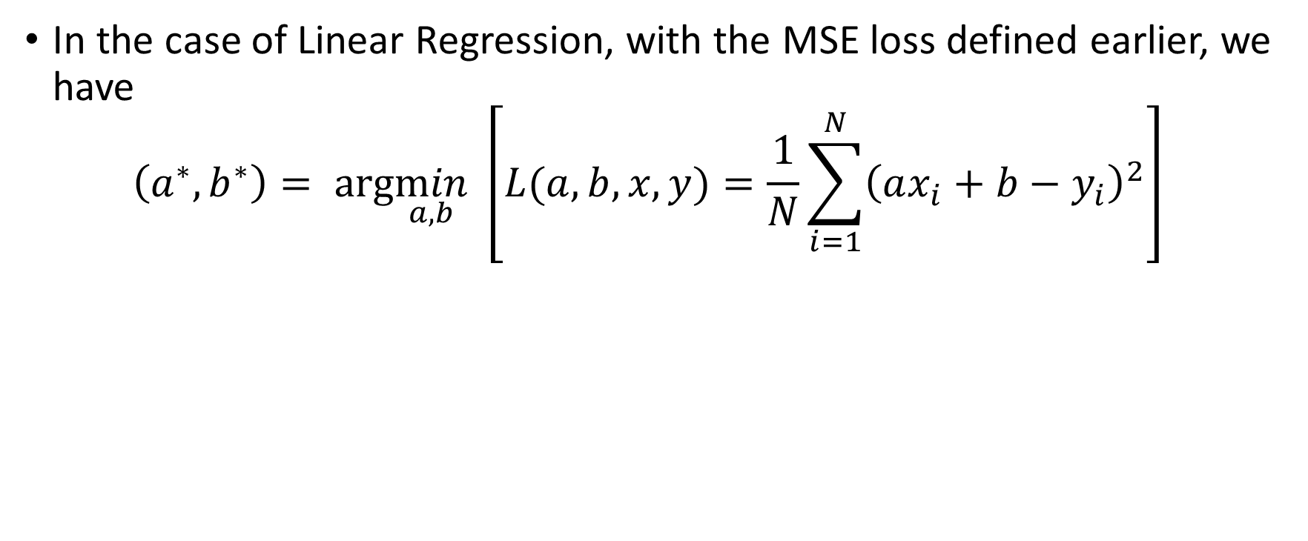
GD in Linear Regression
In the case of Linear Regression, with the MSE loss defined earlier, we have
$$\left(a^{∗},b^{∗}\right)= arg\min_{a,b} \left[L(a, b,x, y)=\frac{1}{N}\sum_{i=1}^{N}{{\left(ax_{i}+b−y_{i}\right)}^{2}}\right]$$

Slide 86

GD in Linear Regression
We have the following derivatives with respect to $a$ and $b$:
$$D_{a}=\frac{∂L}{∂a}= \frac{−2}{N} \sum_{i=1}^{N}{x_{i} \left(y_{i} − \left(a x_{i} + b\right)\right)}$$
$$D_{b}= \frac{∂L}{∂b} =\frac{−2}{N}\sum_{i}^{N}{y_{i} − (a x_{i} + b)}$$

Slide 87

GD in Linear Regression
The gradient descent update rules are therefore defined as
$$a←a −αD_{a}$$
$$a←a+\frac{2α}{N} \sum_{i=1}^{N}{x_{i} \left(y_{i} − \left(a x_{i} + b\right)\right)}$$
And
$$b←b −αD_{b}$$
$$b←b+\frac{2α}{N}\sum_{i}^{N}{y_{i} − (a x_{i} + b)}$$
With parameter 𝛼 being the learning rate for the gradient descent, a parameter to be decided manually, later.

Slide 88

GD in Linear Regression
Gradient Descent Linear Regression procedure:
We will then initialize $a$ and $b$ with some values (could be zero, random, or something else).
For a given number of iterations, we will apply the two update rules defined earlier.
(Optionally, we might decide to stop iterating, if we realize that the values of $a$ and $b$ are no longer changing. This is called early stopping, and is typically implemented by tracking the changes on each iteration and breaking if the changes are less than a threshold $δ$.)

Slide 89

Initialize a and b as you please.

Slide 90
Number of samples in dataset.

Slide 91
Two possible stopping conditions, change < delta or counter > max_count

Slide 92
Update using our GD update rules from earlier

Slide 93
Compute change on this iteration (to decide on early stopping or not)

Slide 94
Calculate new MSE value using the new parameters a and b. We also keep track of these losses for display later

Slide 95
Return trained parameters and losses evolution on each iteration

Slide 96


Slide 97


Slide 98

Checking for optimal parameters
We have generated the dataset ourselves, so we know what should be the values for a and b!

Slide 99


Slide 100

Using Sklearn for Linear regression
In practice, we never implement the linear regression model ourselves (but it is a good practice to try it at least once!)
It is often faster to rely on the sklearn library and use the LinearRegression object!

Slide 101

Predicting using Sklearn Linear regression
After training, it is also good practice to check if the predictor makes sense, by asking it to predict the price of an apartment it has never seen before.
Confirm the value manually, if possible.

Slide 102

Extension of multi-parameter Linear Regression
Let us now consider that the inputs consist of more than one parameter, e.g. each sample $x_{i}$ consists of:
The surface $x_{i}^{1},$
The distance to closest MRT $x_{i}^{2},$
Etc.
The linear regression can be simply transposed.

Slide 103

Extension of multi-parameter Linear Regression
Definition (Multi-parameter Linear Regression):
Multi-parameter Linear Regression is a model, which assumes that there is a linear relationship between inputs and outputs.
It therefore consists of several trainable parameters $(a_{1, }a_{2},…a_{K},b)$, to be freely chosen.
These will connect any input $x_{i}=\left(x_{i}^{1},x_{i}^{2},…,x_{i}^{K}\right)$ to its respective output $y_{i}$, with the following equation:
$$y_{i}≈\sum_{k=1}^{K}{a_{k} x_{i}^{k}} + b$$

Slide 104

Extension of multi-parameter Linear Regression
The MSE loss then becomes:
$$L=\frac{1}{N}\sum_{i=1}^{N}{{\left(\sum_{k=1}^{K}{a_{k}x_{i}^{k}}+b−y_{i}\right)}^{2}}$$
And the optimization problem related to training is then:
$$\left(a_{1}^{∗}, …,a_{K}^{∗}, b^{∗}\right)= arg\min_{a_{1},…,a_{K},b}L$$

Slide 105

Extension of multi-parameter Linear Regression
We could then try to compute the new normal equation for this problem (good practice for your optimization skills, try it out!)
Or, and it is often preferable, we could then define gradient descent update rules with respect to every trainable parameter $(a_{1, }a_{2},…a_{K},b)$ like before.
However, we leave this implementation for students who would like to practice. (or it might be the homework for this week!)

Slide 106

From Linear to Polynomial Regression
Definition (Polynomial Regression with degree K):
Polynomial Regression is a model, which assumes that there is a polynomial relationship between inputs and outputs, which can be defined as a polynomial function of degree $K$.
It therefore consists of several trainable parameters $(a_{1, }a_{2},…a_{K},b)$, to be freely chosen.
These will connect any input $x_{i}=\left(x_{i}^{1},x_{i}^{2},…,x_{i}^{K}\right)$ to its respective output $y_{i}$, with the following equation:
$$y_{i}≈\sum_{k=1}^{K}{a_{k} {\left(x_{i}\right)}^{k}} + b$$

Slide 107

The hyperplane concept
Definition (Hyperplanes in Linear Algebra):
A hyperplane is a subspace of one dimension less than the ambient space.
In the case of linear regression with one input feature and one output feature, the ambient space is of dimension 2 (that is 1+1).
The Linear Regression model equation, is defined as
$$y= ax+b$$
This is the equation of a line, which is a 1D subspace, therefore an hyperplane of the 2D ambient space.
The same happens with the polynomial regression, but at a higher degree.

Slide 108

From Linear to Polynomial Regression
We will follow the same steps as before with linear regression, starting with a mock dataset.
This will be different compared than what has been implemented in notebooks 1 and 2, as we will generate prices $y_{i}$ as a polynomial function of the surfaces $x_{i}$.
We will assume that the function $y=f(x)$, giving the price of an apartment with surface $x$, is defined as a polynomial function with degree 3.
$$y=f(x) = 100000 + 14373x + 3x^{3}$$
In addition, we will add a random noise to the final pricing, with a +/- 10% drift as before.

Slide 109

From Linear to Polynomial Regression
We will follow the same steps as before with linear regression, starting with a mock dataset.
This will be different compared than what has been implemented in notebooks 1 and 2, as we will generate prices $y_{i}$ as a polynomial function of the surfaces $x_{i}$.
We will assume that the function $y=f(x)$, giving the price of an apartment with surface $x$, is defined as a polynomial function with degree 3.
$$y=f(x) = 100000 + 14373x + 3x^{3}$$
In addition, we will add a random noise to the final pricing, with a +/- 10% drift as before.

Slide 110

From Linear to Polynomial Regression

Slide 111

Data no longer shows linearity, which is expected.
Using a Linear Regressor would be a mistake, as it would not properly fit the data.

Slide 112


Polynomial Regression with sklearn
Sklearn treats polynomial regression as a multi-parameter linear regression, with polynomial features.
Polynomial features: reworking the inputs so that
$$\tilde{X}=\left(\begin{matrix}x_{1} & ⋯ & {\left(x_{1}\right)}^{K} \\ ⋮ & ⋱ & ⋮ \\ x_{N} & ⋯ & {\left(x_{N}\right)}^{K}\end{matrix}\right)$$
And ${\tilde{x}}_{i,j}={\left(x_{i}\right)}^{j}$

Slide 113


Polynomial Regression with sklearn
We then proceed normally, assuming $\tilde{X}$ are our new inputs.
Sklearn then automatically adjusts and produces the right number of parameters for the model.

Slide 114

A much better fit, with a lower MSE loss

Slide 115

Be careful however on the degree you use for the polynomial regression.
Higher degree is not always better!

Slide 116
Be careful however on the degree you use for the polynomial regression.
Higher degree is not always better!
Red model (high degree) will struggle to predict price of a 150sqm apartment!

Slide 117

Overfitting vs. degree of polynomial
Red curve shows what happens when using a degree $K$ that is too high compared to the relationship connecting inputs and outputs (it was 3).
This phenomenon is called overfitting.

Slide 118
Overfitting vs. degree of polynomial
Definition (Overfitting):
Overfitting is a phenomenon that occurs in machine learning when a model is trained too well on the training data.
As a result, it performs poorly on new, unseen data (here an apartment with 150sqm surface, which we had not in the training dataset).

Slide 119
Overfitting vs. degree of polynomial
Definition (Overfitting):
Overfitting is a phenomenon that occurs in machine learning when a model is trained too well on the training data.
As a result, it performs poorly on new, unseen data (here an apartment with 150sqm surface, which we had not in the training dataset).
This typically happens when
a model is trained with too many features
or too much data,
It becomes too complex for the task at hand, resulting in poor generalization to new data.
In other words, it memorizes the noise in the training data rather than learning the correct underlying pattern.

Slide 120

Underfitting vs. degree of polynomial
Definition (Underfitting):
Underfitting is a phenomenon that occurs in machine learning when a model is not capable enough to capture the underlying pattern of the data.
For instance, here, Linear Regression (which is Polynomial Regression with $K = 1$) could not fit the data well.

Slide 121
Underfitting vs. degree of polynomial
Definition (Underfitting):
Underfitting is a phenomenon that occurs in machine learning when a model is not capable enough to capture the underlying pattern of the data.
For instance, here, Linear Regression (which is Polynomial Regression with $K = 1$) could not fit the data well.
This can happen when a model
is trained with too few features
or too little data,
or when the model is not powerful enough to capture the complexity of the task.

Slide 122
Generalization
Definition (Generalization):
Generalization is considered the "holy grail" of machine learning because it is the ultimate goal of any machine learning model.
Even though the model was trained on seen data we collected, the purpose of a machine learning model is to make accurate predictions on new, unseen data.
If a model can make accurate predictions on data it has not seen before, it is said to have generalized well, and can then be used in the real world for solving the problem it was designed to solve.

Slide 123

Generalization vs. Overfitting/Underfitting
In general, having a model that is underfitting or overfitting will lead to poor generalization.
We would very much prefer to fit the data “just right”.

Slide 124
While we are at it…
In general, we want to:
Train the model was trained on data we collected,
Confirm that the model can generalize and make accurate predictions on new, unseen data, after training.
Problem: We would prefer to test the model before releasing it in the wild (what if it is wrong?)
Problem #2: Testing its generalization capabilities on the same data that was used for training would NOT confirm generalization.
Solution: Use some of our seen data to train the model, and some of the data (that has not been used for training and is therefore unseen to the model yet) for evaluating its generalization.

Slide 125

Train and test split
Definition (Train and Test Split):
Train and test split is a method used in machine learning to divide a dataset into two subsets:
The training set is used to train the model
The test set is used to evaluate the performance of the trained model.
The idea is to use a portion of the dataset for training and a separate portion for testing so that the model can be evaluated on unseen data.
The typical split is to use 80% of the data for training and 20% for testing.
This can however vary depending on the specific use case and the size of the dataset.

Slide 126

Train and test split

Slide 127


Slide 128

Training the Polynomial Regressor, again
This time, we only train the polynomial regressor on the training data.
After training, evaluate loss using the test data.

Slide 129

Red curve is higher degree polynomial regression. While it seems like it should perform better than black, its test loss is higher!
What could be the reason?

Slide 130
Red curve is higher degree polynomial regression. While it seems like it should perform better than black, its test loss is higher!
What could be the reason?
Bad fitting on low surface apartments!
(No apartment with size less than 45sqm in train dataset!)

Slide 131

Generalization vs. Train/Test Distributions
Definition (The need for train and test distribution similarity):
In order to generalize well in is important that the train and test set are following similar distributions.
$$P_{train}≈P_{test}$$
Here, we ended up having a problem, as our training dataset did not contain any apartments with size lower than 45sqm.
I mean, you would not train a model on Singaporean apartments and use it to predict the price of apartments in Kuala Lumpur, right?

Slide 132
But then, why did black end up being ok then? It had not seen the <45sqm data either!

Slide 133
Regularization
Definition (Regularization):
Regularization consists of helping the model avoid overfitting (which is usually more prominent than underfitting).
It can typically be done by making sure the model is not too complex for the data, but many other approaches exist.
In general,
the more complex the data is (in terms of features), the more complex the model can be.
the more data you have (in terms of quantity of individual samples in dataset), the more complex the model can be.

Slide 134

Regularization
Definition (Regularization):
Regularization consists of helping the model avoid overfitting (which is usually more prominent than underfitting).
It can typically be done by making sure the model is not too complex for the data, but many other approaches exist.
A more common approach consists of adding a penalty term to the loss function.
The penalty term, also known as a regularization term, discourages the model from assigning too much weight to any one feature, i.e. making a certain parameter $a_{k}$ too prominent (leading to overfitting).

Slide 135


Regularization
Definition (Ridge Regression):
The Ridge Polynomial Regressor is a polynomial regressor, like described earlier.
Its only difference is the loss function includes an additional regularization term $λ R(a, b)$.
This regularization term consists of the sum of the squared values for the trainable parameters, i.e.:
$$λ R\left(a, b\right)=\frac{λ}{2N}\left( \sum_{k}^{M}{{ \left(a_{k}\right)}^{2}} + {\left(b\right)}^{2}\right)$$
This regularization term encourages the model to assign low values to the coefficients of the model.
This will, in turn, lead to less overfitting. Indeed, overfitting often occurs when high values are assigned to coefficients for high degrees (i.e. coefficients $a_{k}$with for high $k$ values).

Slide 136


Slide 137

Regularization
Definition (Ridge Regression):
The Ridge Polynomial Regressor is a polynomial regressor, like described earlier.
Its only difference is the loss function includes an additional regularization term $λ R(a, b)$.
This regularization term consists of the sum of the squared values for the trainable parameters, i.e.:
$$λ R\left(a, b\right)=\frac{λ}{2N}\left( \sum_{k}^{M}{{ \left(a_{k}\right)}^{2}} + {\left(b\right)}^{2}\right)$$
Note: Just like the learning rate in GD, the parameter $λ$ is manually decided and is used to weight the importance of the regularization term compared to the MSE.
If the value for 𝜆 is small, the loss function will be mostly MSE and our model will therefore suffer from the same overfitting problems as earlier.
If the value of 𝜆 is too high however, the model will mostly ignore the MSE part of the loss function, which will lead to a model not fitting (or underfitting) the data.

Slide 138


Slide 139
Regularization
Definition (Ridge Regression):
The Ridge Polynomial Regressor is a polynomial regressor, like described earlier.
Its only difference is the loss function includes an additional regularization term $λ R(a, b)$.
This regularization term consists of the sum of the squared values for the trainable parameters, i.e.:
$$λ R\left(a, b\right)=\frac{λ}{2N}\left( \sum_{k}^{M}{{ \left(a_{k}\right)}^{2}} + {\left(b\right)}^{2}\right)$$
Note #2: it is also possible to use the sum of absolute values, making a Lasso Regressor instead.
Why use L1 regularization over L2 regularization?
L1 regularization results in some weights being exactly equal to zero, which can be used for feature selection.
L2 regularization will not produce sparse models, and it will only shrink the weights.

Slide 140
Regularization
Definition (Ridge Regression):
The Ridge Polynomial Regressor is a polynomial regressor, like described earlier.
Its only difference is the loss function includes an additional regularization term $λ R(a, b)$.
This regularization term consists of the sum of the squared values for the trainable parameters, i.e.:
$$λ R\left(a, b\right)=\frac{λ}{2N}\left( \sum_{k}^{M}{{ \left(a_{k}\right)}^{2}} + {\left(b\right)}^{2}\right)$$
Note #3: it is also possible to use the sum of absolute values AND squared values as regularization
Essentially getting the best of both worlds, and making an Elastic Regressor instead!
Check it out!

Slide 141


Introducing the sigmoid function
Definition (the sigmoid function):
The sigmoid function is an important function used in Machine Learning. It is defined as
$$s\left(x\right)=\frac{1}{1+\exp\left(−x\right)}$$
Or, equivalently
$$s(x)=\frac{exp⁡(x)}{1+exp⁡(x)}$$
Note: Sometimes, the notation $σ\left(x\right)$ is used instead of $s(x)$.
The sigmoid function has the following properties:
$$∀ x, 0 < s(x) < 1$$
$$\lim_{x→ −∞} s(x) = 0$$
$$\lim_{x→∞} s(x) = 1$$
$$s(0) = 0.5$$

Slide 142


Introducing the sigmoid function
Definition (the sigmoid function):
The sigmoid function is an important function used in Machne Learning. It is defined as
$$s\left(x\right)=\frac{1}{1+\exp\left(−x\right)}$$
Or, equivalently
$$s(x)=\frac{exp⁡(x)}{1+exp⁡(x)}$$
The sigmoid function has the following properties:
$$∀ x, 0 < s(x) < 1$$
$$\lim_{x→ −∞} s(x) = 0$$
$$\lim_{x→∞} s(x) = 1$$
$$s(0) = 0.5$$

Slide 143


Introducing two logistic functions
Definition (the logistic functions):
Similarly, let us introduce two logistic functions, below:
$$l(x)=ln⁡(x)$$
$$l_{2}(x)=ln⁡(1−x)$$
These two functions also have interesting properties.
$$\lim_{x→0} l(x)=−∞$$
$$\lim_{x→1} l\left(x\right)=0$$
$$\lim_{x→0} l_{2}(x)=0$$
$$\lim_{x→1}{ l}_{2}\left(x\right)=−∞$$
$$l(0.5)=l_{2}(0.5)=−ln⁡(2)$$

Slide 144



To recap
Definition (the sigmoid function):
$$s\left(x\right)=\frac{1}{1+\exp\left(−x\right)}$$
Or, equivalently
$$s(x)=\frac{exp⁡(x)}{1+exp⁡(x)}$$
Definition (the logistic functions):
$$l(x)=ln⁡(x)$$
And,
$$l_{2}(x)=ln⁡(1−x)$$

Slide 145

Introducing two logistic functions
Definition (the logistic functions):
Similarly, let us introduce two logistic functions, below:
$$l(x)=ln⁡(x)$$
$$l_{2}(x)=ln⁡(1−x)$$
These two functions also have interesting properties.
$$\lim_{x→0} l(x)=−∞$$
$$\lim_{x→1} l\left(x\right)=0$$
$$\lim_{x→0} l_{2}(x)=0$$
$$\lim_{x→1}{ l}_{2}\left(x\right)=−∞$$
$$l(0.5)=l_{2}(0.5)=−ln⁡(2)$$

Slide 146

Introducing two logistic functions
In addition, the following properties hold (some of them require using L'Hospital rule to prove them, try it out?).
$$\lim_{x→0} x ln(x)=0$$
$$\lim_{x→1} x ln\left(x\right)=0$$
$$\lim_{x→0} \left(1−x\right) ln⁡(1−x)=0$$
$$\lim_{x→1} \left(1−x\right) ln⁡(1−x)=0$$

Slide 147

Introducing two logistic functions
In addition, the following properties hold (some of them require using L'Hospital rule to prove them, try it out?).
$$\lim_{x→0} \left(1−x\right) ln\left(x\right)=−∞$$
$$\lim_{x→1}\left(1−x\right) ln\left(x\right)=0$$
$$\lim_{x→0} x ln⁡(1−x)=0$$
$$\lim_{x→1} x ln⁡(1−x)=−∞$$

Slide 148


Introducing two logistic functions
In addition, the following properties hold (some of them require using L'Hospital rule to prove them).
$$\lim_{x→0} \left(1−x\right) ln\left(x\right)=−∞$$
$$\lim_{x→1}\left(1−x\right) ln\left(x\right)=0$$
$$\lim_{x→0} x ln⁡(1−x)=0$$
$$\lim_{x→1} x ln⁡(1−x)=−∞$$

Slide 149


Mock dataset generation
In notebook 6, we will prepare a dataset for a single-variable binary classification.
The inputs, $x$, will consist of chest sizes for male between 94cm and 114cm, randomly generated.
The outputs, $y$, will consists of two classes, corresponding to the shirt size to use, with two possible values:
M (class with value 0, if chest size is below 104 cm) size
and L size (class with value 1, if chest size is above 104 cm).

Slide 150


Slide 151


Slide 152

A quick word about expert systems
Definition (expert systems):
An expert system is a computer program that mimics the decision-making abilities of a human expert in a specific domain or field.
It uses knowledge represented in a symbolic form, such as rules or ontologies, to make inferences and decisions based on the data it receives.
Expert system provide a high level of performance and accuracy in solving problems or making decisions but these are difficult to design as they require human expertise.

Slide 153

A quick word about expert systems
Definition (expert systems):
An expert system is a computer program that mimics the decision-making abilities of a human expert in a specific domain or field.
It uses knowledge represented in a symbolic form, such as rules or ontologies, to make inferences and decisions based on the data it receives.
In our case, we could define as expert system like so, but most of the time the datasets will not have a clear logic and you will have to rely on ML algorithms instead, basically “praying for the AI to figure out a logic that works”.

Slide 154


From Linear Regression to Logistic Regression
Definition(Logistic Regression):
The logistic regression model assumes that the classes $y_{i}$ for every sample$x_{i}$are connected via the formula below.
$$∀i, y_{i}= \left\{\begin{matrix}1 & if p(x_{i})>0.5 \\ 0 & otherwise\end{matrix}\right.$$
This value $p(x)$is often referred to as the probability of sample with value $x$ being of class 1 (that is L size).
Respectively, $1 − p(x)$is therefore the probability of sample with value $x$ being of class 0 (that is M size).
The probability function is then simply defined as
$$p\left(x\right)=s\left(ax+b\right)$$
The function $p$always has values between 0 and 1, thanks to the sigmoid function $s$ we defined earlier.

Slide 155


From Linear Regression to Logistic Regression
Definition(Logistic Regression):
The logistic regression model assumes that the classes $y_{i}$ for every sample$x_{i}$are connected via the formula below.
$$∀i, y_{i}= \left\{\begin{matrix}1 & if s(a x + b)>0.5 \\ 0 & otherwise\end{matrix}\right.$$
This value $s(ax+b)$is often referred to as the probability of sample with value $x$ being of class 1 (that is L size).
This model has two trainable parameters, $a$ and $b$, to be decided like in the linear regression.
In fact, we could see the logistic regression as the combination of linear regression and sigmoid together.
In addition, note that the function $f(x) = a x + b$is also often referred to as the logit function with value $x$.

Slide 156

From Linear Regression to Logistic Regression
We can implement the logistic regression below and try it out with some values a and b!

Slide 157


Slide 158

Training a logistic regressor
As before, in linear regression, we will have to train the model, i.e. choose values for $a$ and $b$, that fit the dataset.
While MSE seemed to work as a loss function to minimize for the linear regression model, it will simply not do here.
We need something else.
In logistic regression, we minimize a function, called the log-likelihood function, instead (after it has been multiplied by -1).
This function has to do with the two logistic functions we have introduced earlier.

Slide 159

The log-likelihood function and loss
Definition (the log-likelihood function):
The log-likelihood function is defined as
$$L=\frac{1}{N}\left[x_{i}\ln\left(s\left(ax_{i}+b\right)\right)+\left(1−x_{i}\right)\ln\left(1−s\left(ax_{i}+b\right)\right)\right]$$
This is a good function to use for our problem for the two reasons:
When $p(x_{i})$ is close to the ground truth value $y_{i}$, both terms of the loss function, will have values close to 0. This follows from the properties we defined earlier for the logistic functions.
On the opposite, the log-likelihood loss function will have a different behaviour when $p(x_{i})$ and the ground truth value $y_{i}$ are different, producing larger non-zero negative values.

Slide 160

The log-likelihood function and loss
Definition (using the log-likelihood function as a loss):
This log-likelihood loss function is therefore a good choice of a performance metric to measure the performance of our models.
Indeed, maximizing this log-likelihood loss function would be equivalent to finding the best choice of parameters 𝑎 and 𝑏, and therefore the best fit.
In practice however, we prefer to minimize loss functions. This requires a simple adjustment, simply multiplying the loss function by -1.
$$a^{∗},b^{∗}=\arg{\min_{a,b}\left[\frac{−1}{N}\left[x_{i}\ln\left(s\left(ax_{i}+b\right)\right)+\left(1−x_{i}\right)\ln\left(1−s\left(ax_{i}+b\right)\right)\right]\right]}$$

Slide 161

Implementing the log-likelihood loss
We can simply implement the log likelihood loss as shown below.
We could look for the normal equation for logistic regression, but this simply will not work.
Indeed, it is simply impossible to solve the logistic regression problem analytically.

Slide 162

Training a logistic regressor
Instead, it is often preferable to rely on heuristics, such as the gradient descent method, or the Newton method.
Typically, this is what the LogisticRegression() object in sklearn uses for training!
(Not covered but feel free to try it out?)

Slide 163


Slide 164

Evaluating the logistic regression model
When attempting to evaluation a classification model, it is often a good idea to first display a confusion matrix for the predicted values of the dataset samples.
We can simply calculate it by using the confusion_matrix() function from sklearn. The non-diagonal elements have zero values, which is the sign that our model classifies perfectly.
Learn more, here: https://scikit-learn.org/stable/modules/generated/sklearn.metrics.confusion_matrix.html.

Slide 165
Evaluating the logistic regression model
We can also ask for a classification report for the model.
This shows the precision, recall and F1 scores for each class, as well as the overall accuracy of the model.
For each one of these metrics, the best value is 1.0, and our model exhibits it, suggesting again that the model classifies perfectly.
Learn more, here: https://scikit-learn.org/stable/modules/generated/sklearn.metrics.classification_report.html#sklearn.metrics.classification_report.

Slide 166

A bit of biology
Question: are neurons in Neural Networks really close to the actual human brain?
Neural networks are inspired by the neural structure and processes of the human brain.
Neural networks are comprised of interconnected nodes, which are called neurons.
Neural networks are related to biology in that they are modeled after biological neural systems.

Slide 167
A bit of biology
The neurons in a neural network are similar to the neurons in the brain in that they are connected to each other and can send and receive signals.
Furthermore, the training process of a neural network is analogous to the learning process of a biological neural network.
The neurons are adjusted and adapted in order to learn, just as neurons in the brain are modified in order to learn new information.

Slide 168
A bit of biology
Research has also shown that artificial neural networks can be used to solve some of the same types of problems that biological neural networks can solve.
For example, neural networks can be used to identify objects in images, just as biological neural networks can.
Ongoing argument: see [Quanta2021] and [MITNews2022].

Slide 169

Starting with a mock dataset, again
As before, we will try to come up with a model capable of predicting the price of an apartment based on some of its features.
The inputs will this time consist of two parameters:
the surface of the apartment, in sqm, just like before,
and the distance between the apartment and the closest MRT station in meters.
We will generate a mock dataset by:
randomly drawing surfaces between 40 sqm and 200sqm,
randomly drawing distances between 50 and 1000m,
generate prices by assuming that the average price is simply defined as
$$avgprice = 100000 + 14373× surface + \left(1000 − distance\right)× 1286$$
Finally, we will randomly apply a -/+ 10% variation on the average price to create some variance, and call that the output for a given sample.

Slide 170

Starting with a mock dataset, again

Slide 171


Slide 172


Slide 173


Slide 174
Coding a Neuron and a Neural Network
Definition (Neuron in Neural Networks):
Each artificial neuron in a neural network is like a logistic regression model, which receives input, applies a transformation on that input, and produces an output.
And similar to the way that biological neurons are connected and communicate with each other, artificial neurons are connected to each other through a network of edges, which can be thought of as pathways for information to flow through the network.

Slide 175

Coding a Neuron and a Neural Network

Slide 176

Coding a Neuron and a Neural Network

Slide 177


Slide 178

Defining a minimal Neural Network
Definition (defining a minimal Neural Network):
In order to define a minimal neural network, we need two things:
First, an __init__ method, listing the trainable parameters for the model.
In our case that is a weight vector $W=(w_{1}, w_{2})$ with 2 elements and a single scalar bias value $b$.
Second, a forward method, which will be used to formulate predictions for any set of given inputs.
The prediction formula is simply $y_{i}=w_{1}s_{i}+w_{2}d_{i}+b$.

Slide 179


Slide 180
Adding a loss
This takes care of the first three elements of a machine learning model (task, dataset, model).
The fourth element we need is a loss function.
As this is a regression class again, we can reuse the MSE loss and add a method to our class.
We will also reuse the forward method we just coded to make predictions and then compared said predictions with the expected outputs from our dataset.

Slide 181

Adding a loss

Slide 182


Scaling up with more parameters
Technically, our Neural Network could operate with any number of inputs $N_{x}$ and any number of outputs $N_{y}$.
We would simply need to adjust the sizes of the parameters, making:
$W$ as a $N_{x}×N_{y}$ matrix,
B as a $N_{y}$ vector.

Slide 183

Scaling up with more layers
Following the logic of our SimpleNeuralNet, we could now implement a Shallow Neural Network, with its own class ShallowNeuralNet.
It will simply include two processing layers instead of just one, both implementing a $WX + b$operation of some sort.
The first layer, will produce receive inputs with dimensionality $n_{x}$and produce outputs with dimensionality $n_{h}$. The matrix $W$ for this layer will therefore be of size $n_{x}× n_{h}$, and the matrix $b$ will be a simple 1D vector with size $n_{h}$.
The second layer, also called hidden layer, will produce receive inputs from the previous layer with dimensionality$n_{h}$and will produce outputs matching the dimensionality of the outputs in our dataset, that is $n_{y}$. The matrix $W$ for this layer will therefore be of size $n_{h}× n_{y}$, and the matrix $b$ will be a simple 1D vector with size $n_{y}$.

Slide 184

Scaling up with more layers

Slide 185


Our NN class
Changes:
Weights and biases are now randomly generated, instead of being passed to the init method.
We pass the expected sizes $n_{x}, n_{h}, n_{y}$ instead.
Initializing as normal random with zero mean and variance 1.

Slide 186



Initialize model
Forward to predict
Compute loss to evaluate model (it is bad, because trainable parameters have received random values!)

Slide 187

The need for a training procedure
At the moment, we have coded a model that can initialize trainable parameters randomly, formulate predictions and evaluate its own performance.
It is great, but we have no way to compute the weights manually.
We can only try a few different initialization and pray the RNG gods to give us trainable parameters with a good loss.
We need a training procedure!

Slide 188

The backpropagation mechanism
Definition (Backpropagation):
Backpropagation is an algorithm used to train neural networks.
It is a type of gradient descent algorithm that allows the network to learn by adjusting the weights of the connections between the neurons in the network.
Introduced for the first time in [Rumelhart1986].
Or was it? [Medium2020]
Backpropagation will tell our model how to adjust the $W$ and $b$ matrices to improve its loss and prediction capabilities.
This process is called, backpropagation and will be implemented in the backward() method of our model.

Slide 189

Backpropagation in our model
While our Neural Network seems to be complicated in its architecture, at the end of the day, training it simply consists of solving the optimization problem below.
$$W_{1}^{∗},b_{1}^{∗},W_{2}^{∗}, b_{2}^{∗}=\arg{\min_{W_{1},b_{1},W_{2},b_{2}}\left[{\frac{1}{M}\left(Y_{pred}(X,W_{1},b_{1},W_{2},b_{2})−Y \right)}^{2}\right]}$$
$$W_{1}^{∗},b_{1}^{∗},W_{2}^{∗}, b_{2}^{∗}=\arg{\min_{W_{1},b_{1},W_{2},b_{2}}\left[{\frac{1}{M}\left(W_{2}\left(W_{1}X+b_{1}\right)+b_{2}−Y \right)}^{2}\right]}$$
With $M$ being the number of samples in the dataset. We could use gradient descent, like we did for the Linear Regression, except that this time we have 4 parameters and a loss function that is a bit more complex.

Slide 190

Chain rule, to the rescue!
Let us denote the error term $ε$.
$$ε=Y_{pred}(X,W_{1},b_{1},W_{2},b_{2})−Y=W_{2}(W_{1}X+b_{1})+b_{2}−Y.$$
Using the chain rule, we can simply compute $\frac{∂L}{∂W_{2}}$ as
$$\frac{∂L}{∂W_{2}}=\frac{∂L}{∂Y_{pred}}\frac{∂Y_{pred}}{∂W_{2}}$$

Slide 191

Chain rule, to the rescue!
Since we have
$$\frac{∂L}{∂Y_{pred}}=\frac{2}{M}Y_{pred}\left(X,W_{1},b_{1},W_{2},b_{2}\right)−Y=\frac{2ε}{M}$$
And
$$\frac{∂Y_{pred}}{∂W_{2}}=W_{1}X+b_{1}$$
The gradient descent update rule for $W_{2}$ is then
$$W_{2}←W_{2}−\frac{2εα}{M}(W_{1}X+b_{1})$$

Slide 192

Chain rule, to the rescue!
Since we have
$$\frac{∂L}{∂Y_{pred}}=\frac{2}{M}Y_{pred}\left(X,W_{1},b_{1},W_{2},b_{2}\right)−Y=\frac{2ε}{M}$$
$$And \frac{∂Y_{pred}}{∂W_{2}}=W_{1}X+b_{1}$$
The gradient descent update rule for $W_{2}$ is then
$$W_{2}←W_{2}−\frac{2ϵα}{M}(W_{1}X+b_{1})$$
Similarly, we have
$$b_{2}←b_{2}−\frac{2ϵα}{M}$$

Slide 193

Chain rule, to the rescue!
Similarly, we have
$$\frac{∂L}{∂W_{1}}=\frac{∂L}{∂Y_{pred}}\frac{∂Y_{pred}}{∂W_{1}}=\left(\frac{2ε}{M}\right)\left(W_{2}X\right)$$
$$And \frac{∂L}{∂b_{1}}=\frac{∂L}{∂Y_{pred}}\frac{∂Y_{pred}}{∂b_{1}}=\left(\frac{2ε}{M}\right)(W_{2})$$
And therefore, we have
$$W_{1}←W_{1}−\frac{2ϵα}{M}W_{2}X$$
$$b_{1}←b_{1}−\frac{2ϵα}{M}W_{2}$$

Slide 194


Backpropagation in our model
Update rules for $W_{2}$and $b_{2}$
$$W_{2}←W_{2}−\frac{2ϵα}{M}(W_{1}X+b_{1})$$
$$b_{2}←b_{2}−\frac{2ϵα}{M}$$

Slide 195


Backpropagation in our model
Update rules for $W_{1}$and $b_{1}$
$$W_{1}←W_{1}−\frac{2ϵα}{M}W_{2}X$$
$$b_{1}←b_{1}−\frac{2ϵα}{M}W_{2}$$

Slide 196

Backpropagation in our model
Effect of the backpropagation
Every time we call the backward() method, our model will update its parameters,
Eventually becoming better and better at the task in question.
This can be seen by looking at the loss values decreasing after each iteration of the backward() method.

Slide 197


Trainer function for our model
Train function implementation
Iterate the backward() method for a given number of iteration $N_{max}$.
Display new loss values and append them in a list for display later.
Also implemented an early stopping, which will break for loop if no change in parameters during an iteration of backward().

Slide 198

Trainer function for our model

Slide 199

Trainer function for our model
The curves below are called performance/training curves and show how the training went.

Slide 200

Finally, add the trainer function and the performance curves function as methods to our class.

Slide 201
Conclusion (Week 1)
Reminders of Machine Learning
Linear
Using a normal equation to train a linear regression
Gradient descent as a training procedure for linear regression
Polynomial Regression
Regularization in Ridge/Lasso Regression
Train-test split
Overfitting and underfitting
Generalization
Sigmoid and Logistic functions
From linear regression to logistic regression
Using logistic regression for binary classification

Slide 202
Conclusion (Week 1)
Implementing a shallow neural network in Numpy
Forward propagation method, to formulate predictions
The backpropagation mechanism, as the gradient descent on Neural Network
Backward method for training and trainer functions to iterate backward iterations
Performance/training curves
Next week?
Initializations to break symmetries
Exploding and vanishing gradients
Activation functions and non-linearities in Neural Networks
Advanced optimizers
Validation sets, early stopping, saver and loader functions

Slide 203
Learn more about these topics
Out of class, supporting papers, for those of you who are curious.
[Géron2019] A. Géron , “How Neural Networks Work”, 2019.
[Yamins2016] Yamins et al., “Deep neural networks are robust computational models of the human visual system”, 2016.
[Kriegeskorte2013] Kriegeskorte and Kievit, “Neural Network Models of the Human Brain”, 2013.
[Rumelhart1986] D.E. Rumelhart, G. Hinton, Williams, “Learning representations by back-propagating errors“, 1986 https://www.nature.com/articles/323533a0

Slide 204
Learn more about these topics
Tracking important names (Track their works and follow them on Scholar, Twitter, or whatever works for you!)
Geoffrey Hinton: Professor at University of Toronto, one of the three Godfathers of Deep Learning and 2018 Turing Award winner (highest distinction in Computer Science). https://www.cs.toronto.edu/~hinton/ https://scholar.google.co.uk/citations?user=JicYPdAAAAAJ&hl=en
David Rumelhart: Former professor at University of California, credited for inventing backpropagation along with Hinton. Passed away in 2011. https://www.nytimes.com/2011/03/19/health/19rumelhart.html

Slide 205



Twitter, the theater for AI/DL drama and announcements
NYU Professor
Announcing Dall-E 2 and its future release
NYU Professor and Chief of AI at Meta (Facebook)

Slide 206
Learn more about these topics
Some extra (easy) reading and videos for those of you who are curious.
[Quanta2021] “Artificial Neural Nets Finally Yield Clues to How Brains Learn“, 2021. https://www.quantamagazine.org/artificial-neural-nets-finally-yield-clues-to-how-brains-learn-20210218/
[MITNews2022] “Study urges caution when comparing neural networks to the brain”, 2022. https://news.mit.edu/2022/neural-networks-brain-function-1102

Slide 207
Learn more about these topics
Some extra (easy) reading and videos for those of you who are curious.
[Medium2020] “Who Invented Backpropagation? Hinton Says He Didn’t, but His Work Made It Popular“, 2020. https://medium.com/syncedreview/who-invented-backpropagation-hinton-says-he-didnt-but-his-work-made-it-popular-e0854504d6d1/
[MITNews2022] “Study urges caution when comparing neural networks to the brain”, 2022. https://news.mit.edu/2022/neural-networks-brain-function-1102

